Slide 1
By
Suyash Gupta, UC Berkeley
For more inquiries:
Twitter: gupta-suyash
Email: suyash.gupta@berkeley.edu
(Warning: Suyash has been selling BFT since 2022. Per hour rate to increase soon. Hiring organizations may get a discount.)

Slide 2
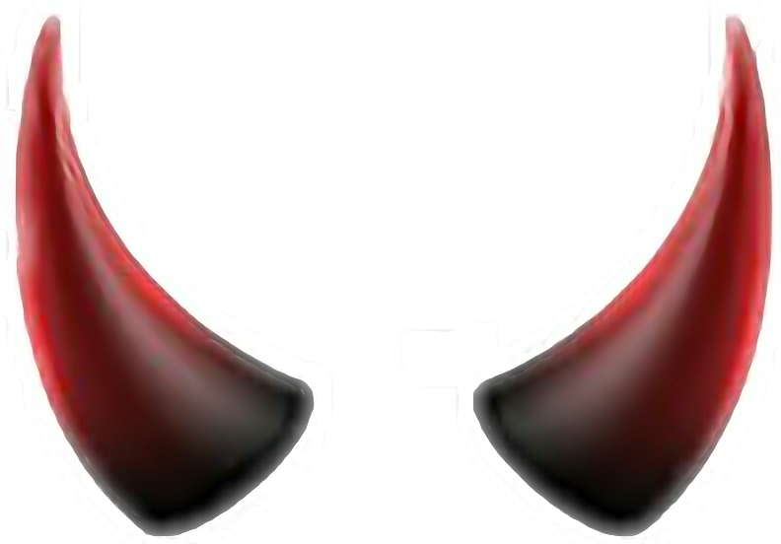
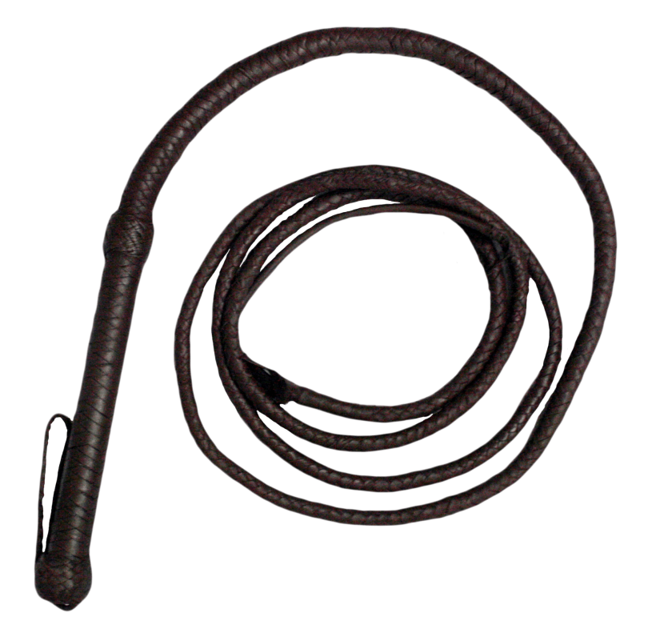
Byzantine Fault Tolerance
Overlooked Sibling of Crash Fault Tolerant Protocols like Paxos

Slide 3
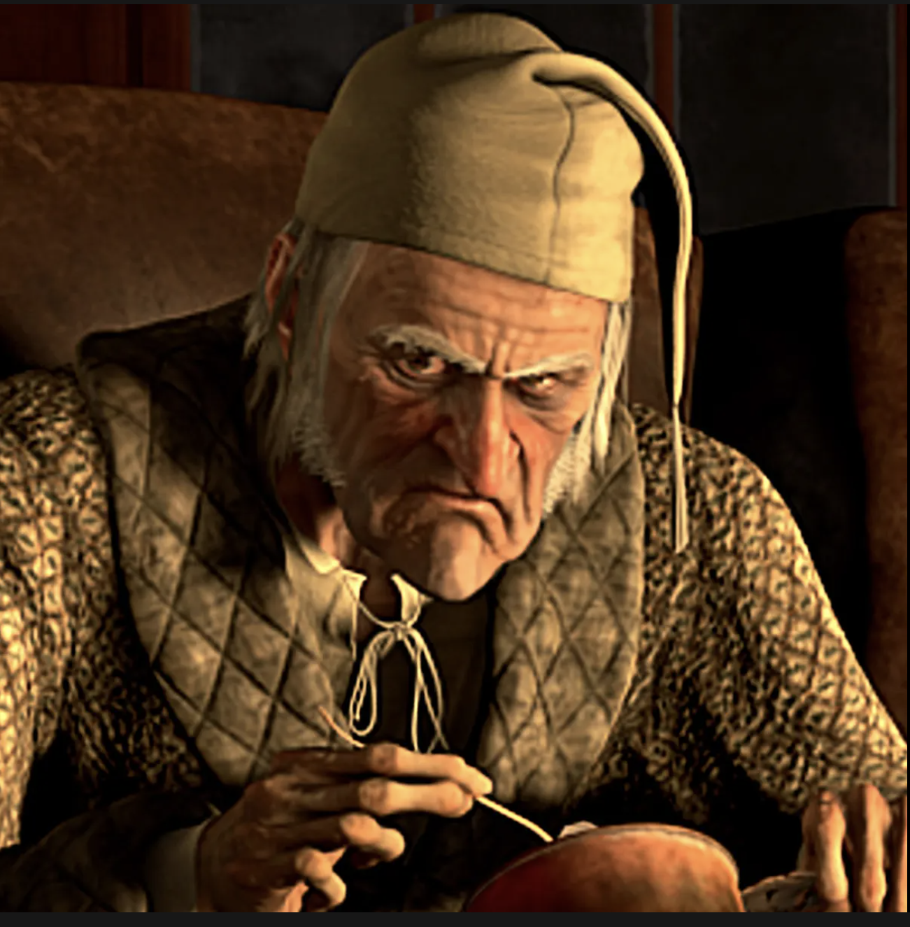
Le DB folks:
Ignoring benefits of BFT consensus.
Le me:
Convincing people why BFT protocols are useful.

Slide 4
BFT Consensus Fulfills desires of Consistent Replication under attack

Slide 5
Common Myths About BFT Consensus
Attacks don’t happen.
Low Throughput
High Latency

Slide 6
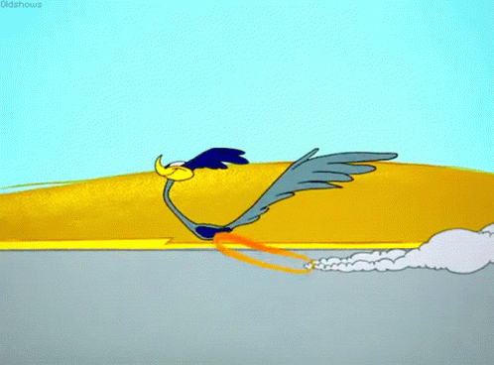
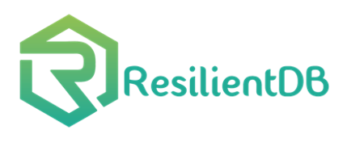
State-of-the-Art
Single Round-trip Protocols.
Parallel Consensus Protocols.
Geo-Scale Consensus.
Sharded-Replicated Consensus.
1 million txns/s

Slide 7
Satisfied Customers
of services provided by BFT
And many more…

