Slide 1
Dissecting BFT Consensus: In Trusted Components we Trust!
Suyash Gupta
SkyLab
University of California, Berkeley
https://gupta-suyash.github.io/

Slide 2
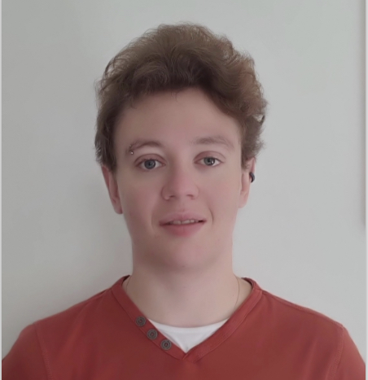
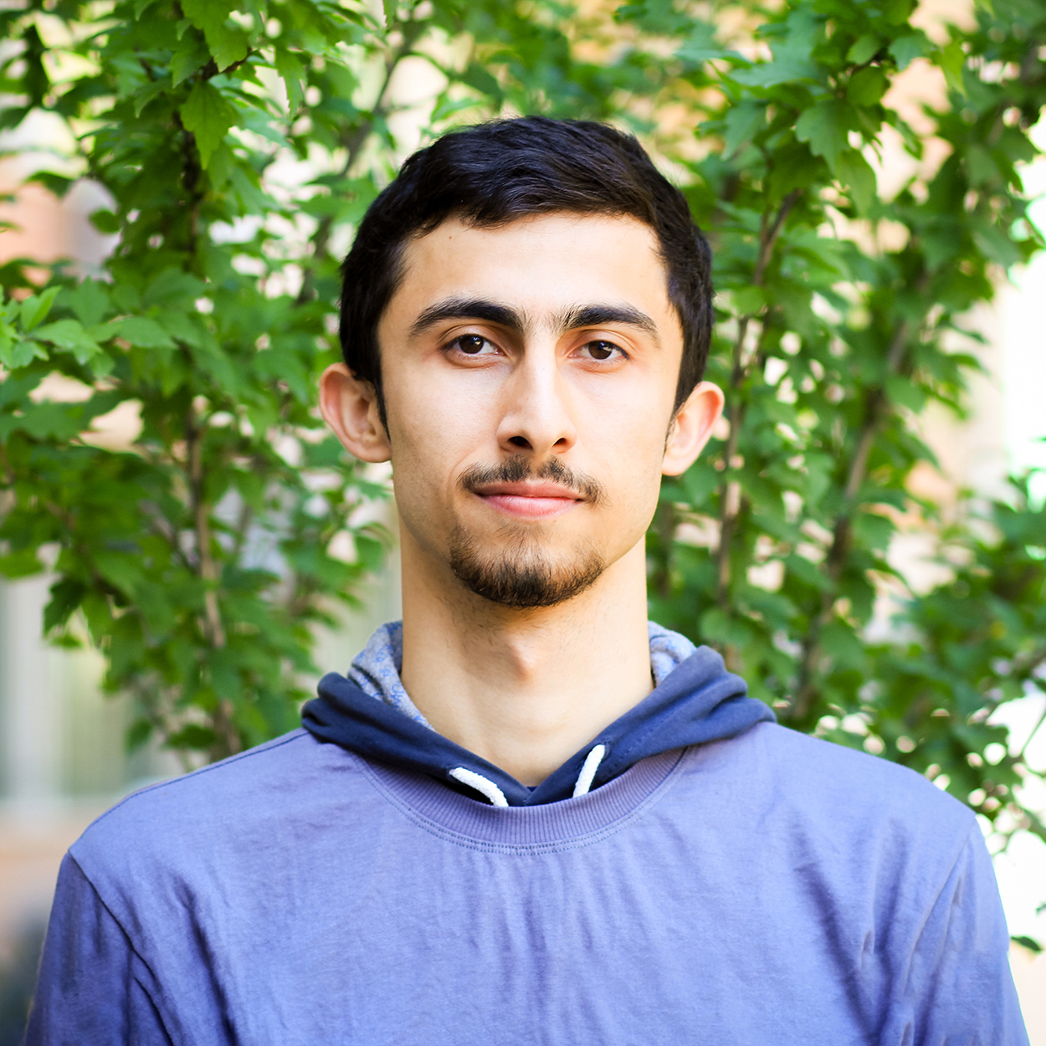
Awesome Collaborators
Natacha Crooks
University of California, Berkeley
Sajjad Rahnama
Mohammad Sadoghi
University of California, Davis

Slide 3
Target of this Talk →
Byzantine-Fault Tolerant (BFT) Consensus
Specifically →
BFT Conensus protocols that use Trusted h/w.
Why? →
Too much trust is placed in Trusted hw.
So? →
Performance Limitations.
Solution →
New Suite of BFT Consensus Protocols that outperform All.

Slide 4
First practical BFT implementation.
Practical Byzantine Fault Tolerance (PBFT)
Alice
T
Primary (P)
Replica (R1)
Replica (R2)
Replica (R3)
Client
Request
Pre-prepare
Prepare
Commit
Reply
Execute
Consensus among n replicas & at most f byzantine → n >= 3f+1
Quorum Size → 2f+1
Reply Quorum Size → f+1
n = 4 replicas and f <= 1

Slide 5
BFT Consensus is Expensive!
Paxos requires n= 2f + 1 replicas.
BFT protocols require n=3f+1 replicas.
Why 3f+1?
Byzantine replicas can equivocate!
Equivocation leads to massive communication.

Slide 6
Maybe Trusted Hardware Can help?

Slide 7
Trusted BFT Protocols
Require each replica to have a co-located trusted component.
Assumption: Trusted component cannot be compromised.
Trusted component attests order for each client request.
Fault-Tolerance: In a system of n replicas at most f byzantine replicas, n >= 2f+1.

Slide 8
Achieves consensus among n replicas with at most f byzantine, n >= 2f+1.
PBFT-EA Protocol
Alice
T
Primary (P)
T_{P}
Replica (R1)
T_{R1}
Replica (R2)
T_{R2}
Client
Request
Pre-prepare
Prepare
Commit
Reply
Execute
Reply Quorum Size → f+1
Each replica has a co-located trusted component.
Quorum Size → f+1
Trusted component returns an attestation.

Slide 9
So Are We Done?
Unfortunately No!

Slide 10
Challenges with Trust-BFT Protocols
We found three limitations in design of Trust-BFT protocols.
We show that Trust-BFT protocols target wrong metric.
Correct metric → Throughput per Machine.

Slide 11
Assume the primary is byzantine and some messages get delayed.
Observation 1: Loss of Responsiveness
A
T
Resend
P
T_{P}
R1
T_{R1}
View
Change
R2
T_{R2}
Client
Request
Pre-Prepare
Prepare
Commit
Reply
Wait
Complain
Execute
Client receives < f+1 responses → Timeouts and Complains.
The message from R1 are indefinitely delayed.
Primary sends Pre-prepare to only one replica
Only R1 replies to the client.
R1 resends reply and R2 requests view change.

Slide 12
Observation 2: Loss of Safety under Rollbacks
Trusted Enclaves can be rollbacked!
Once an enclave is rollbacked, replicas could be inconsistent.
Impossibly hard to rollback are TPMs or persistent counters!
TPMs are too slow → 180ms per access.

Slide 13
Observation 3: Lack Parallel Invocations
Every message sent → Requires attestation.
A replica cannot run consensus on two transactions in parallel!
We show that despite 2f+1 replicas → Trusted-BFT slower than BFT.

Slide 14
Solution → FlexiTrust Protocols
Novel Suite of Protocols.
Guarantee both liveness and responsiveness.
Only one access to trusted component per transaction.
Minimal Memory consumption → No logging at trusted component!

Slide 15
Magical Ingredient behind FlexiTrust Protocols
Switch back to replication factor 3f+1.
Trusted hardware still useful to reduce phases and communication.
Only primary accesses trusted hardware before sending proposal!
Throughput per hardware more than Trusted-BFT.

Slide 16
Single phase, Linear, Handles f failures, Only needs Trusted counters.
Flexi-ZZ Protocol!
Alice
T
Primary (P)
T_{P}
Replica (R1)
Replica (R2)
Replica (R3)
Client
Request
Pre-Prepare
Reply

Slide 17
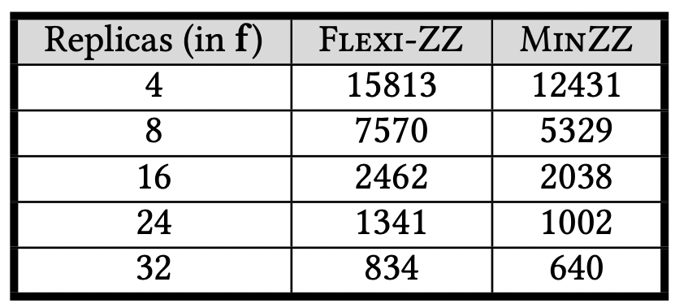
Evaluation on ResilientDB*
Throughput per Machine
MinZZ → Single phase like FlexiZZ but n >= 2f+1.
Use of trusted component limits MinZZ’s throughput.
For these experiments, we used YCSB and deployed up to 80k clients.
*https://resilientdb.com/

Slide 18
Conclusions:
Simply reducing replication will not yield better throughput.
Exisiting Trust-BFT protocols limit responsiveness and scalability.
FlexiTrust protocols advocate meaningful application of BFT consensus.
Check out full version of our paper on arxiv.
Reach me:
Twitter: suyash_sg
Email: suyash.gupta@berkeley.edu

