Slide 1
In Trusted Components we Trust!
Suyash Gupta
SkyLab
University of California, Berkeley
https://gupta-suyash.github.io/

Slide 2
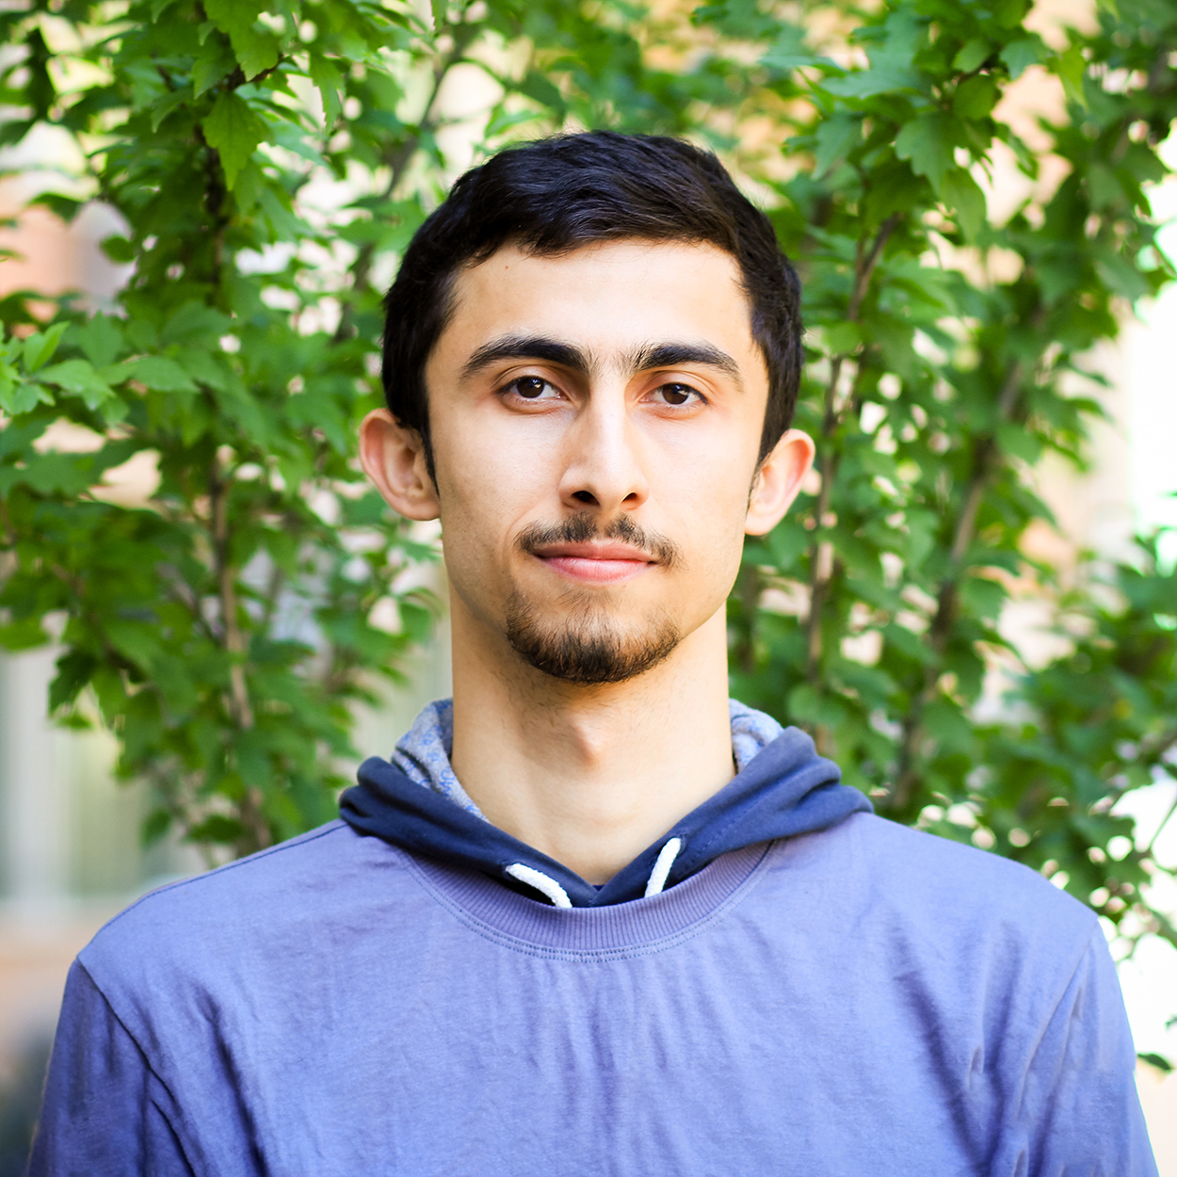
Awesome Collaborators
Natacha Crooks
University of California, Berkeley
Sajjad Rahnama
Mohammad Sadoghi
University of California, Davis

Slide 4
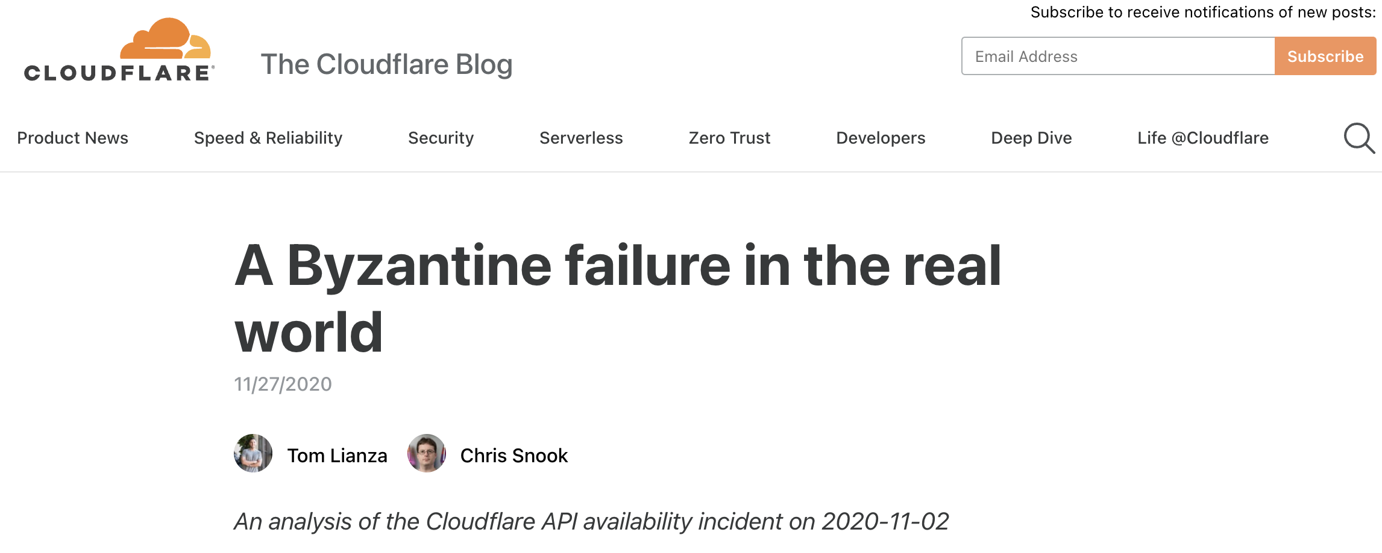
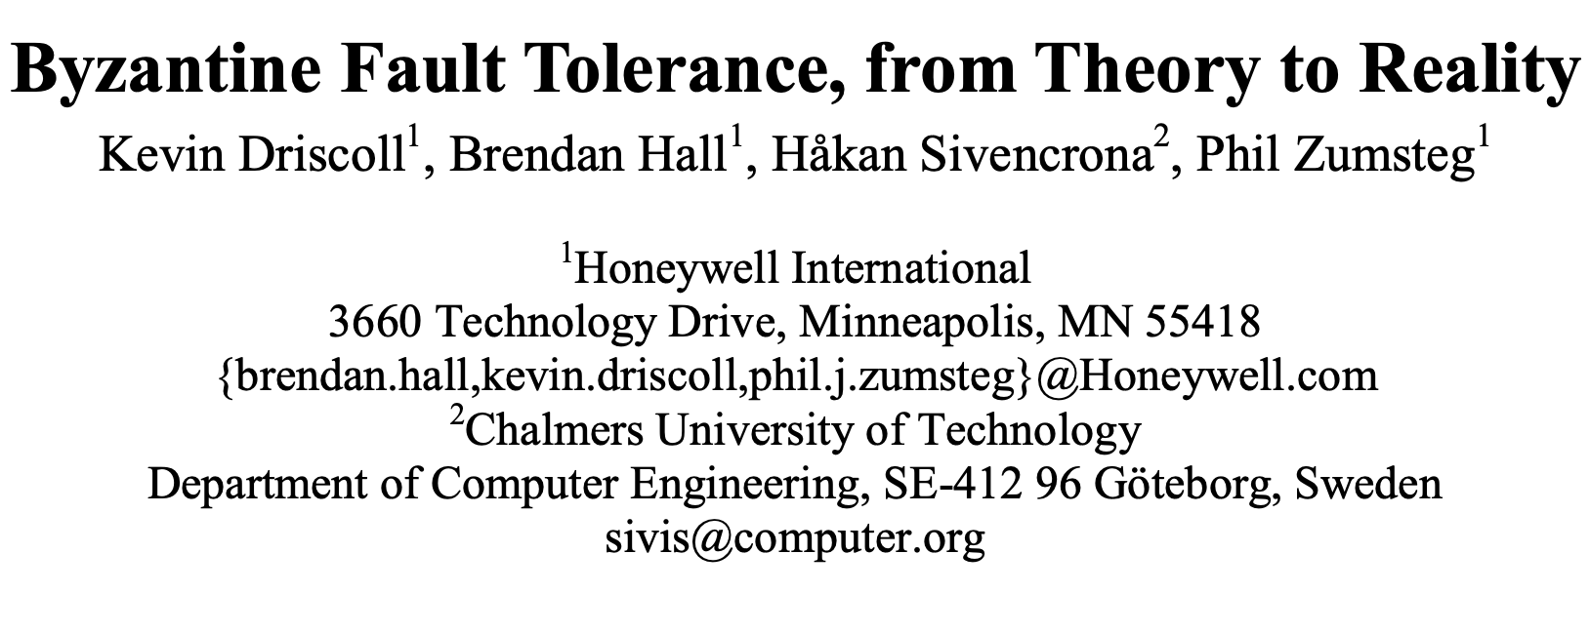
Byzantine Failures Do Not Exist!

Slide 5
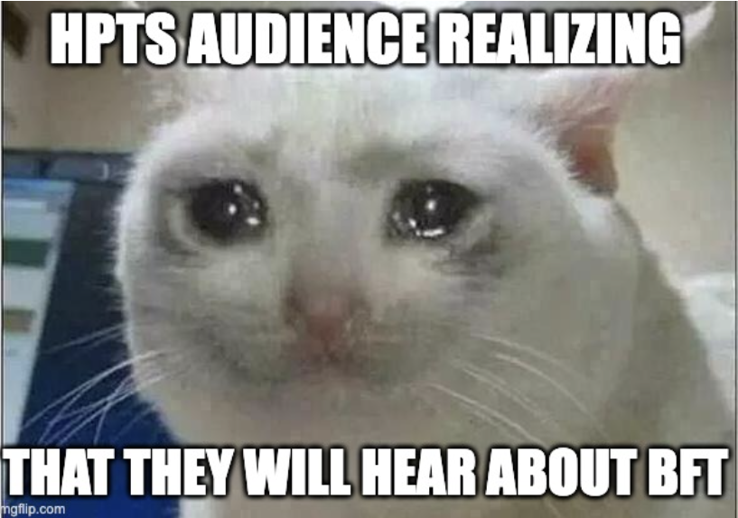

Slide 6
Everything is fine until there are Adversaries!
Alice
Volde

Slide 7
Solution → Byzantine-Fault Tolerant Consensus
Safety
Liveness

Slide 8
Traditional BFT Protocol Flow
Replicas
Proposal
Prepare
Commit
Proposed by primary.
Proposal acceptance
by all replicas.
Proposal durability at all replicas.
Consensus
Transaction
Response
Execution
Client
Agreement Quorum Size: 2f+1
Total Replicas: n = 3f+1
Commitment Quorum Size: 2f+1
Client Quorum Size: f+1

Slide 9
BFT Consensus is Expensive!
Paxos requires n= 2f + 1 replicas.
BFT protocols require n=3f+1 replicas.
Why 3f+1?
Byzantine replicas can equivocate!
Equivocation leads to massive communication.

Slide 10
Need for Trust

Slide 11
Trusted BFT Protocols
Require each replica to have a co-located trusted component.
Assumption: Trusted component cannot be compromised.
Trusted component attests order for each client request.
Fault-Tolerance: In a system of n replicas at most f byzantine replicas, n >= 2f+1.

Slide 12
Trust-BFT Protocol Flow
Replicas
Proposal
Prepare
Commit
Proposed by primary.
Proposal acceptance
by all replicas.
Proposal durability at all replicas.
Transaction
Response
Execution
Client
Commitment Quorum Size: f+1
Total Replicas: n = 2f+1
Agreement Quorum Size: f+1
Client Quorum Size: f+1

Slide 13
So Are We Done?
Unfortunately No!

Slide 14
Challenges for Trust-BFT Protocols!
We found three challenges with the design of Trust-BFT protocols.
We show that Trust-BFT protocols target wrong metric.
Correct metric → Throughput per Hardware

Slide 15
Observation 1: Loss of Responsiveness
Delayed messages from one honest replica → Clients stuck!
Why? Consensus only need weak quorums → f+1
Execution still needs quorum of f+1
Byzantine replicas can always avoid sending messages.

Slide 16
Observation 2: Loss of Safety under Rollbacks
Trusted Enclaves can be rollbacked!
Impossibly hard to rollback are TPMs or persistent counters!
TPMs are too slow → 180ms per access.

Slide 17
Observation 3: Lack Parallel Invocations
Every message sent → Requires attestation.
A replica cannot run consensus on two transactions in parallel!
We show that despite 2f+1 replicas → Trusted-BFT slower than BFT.

Slide 18
Solution → FlexiTrust Protocols
Novel Suite of Protocols.
Guarantee both liveness and responsiveness.
Only one access to trusted component per transaction.
Minimal Memory consumption → No logging at trusted component!

Slide 19
Magical Ingredient behind FlexiTrust Protocols
Switch back to replication factor 3f+1.
Trusted hardware still useful to reduce phases and communication.
Only primary accesses trusted hardware before sending proposal!
Throughput per hardware more than Trusted-BFT.

Slide 20
One Line Conclusion:
Simply reducing replication will not yield better throughput.
FlexiTrust protocols advocate meaningful application of BFT consensus.
Check out:
ResilientDB – VLDB’20 (https://github.com/resilientdb/resilientdb)
Basil – SOSP’21 (https://medium.com/initc3org/decentralizing-databases-with-basil-604827608ff8)
S. Gupta, J. Hellings and M. Sadoghi, Fault-tolerant Distributed Transactions on Blockchain, Morgan & Claypool Synthesis Lectures on Data Management and Springer, 2021.
Reach me:
Twitter: suyash_sg
Email: suyash.gupta@berkeley.edu

