Slide 1
Resilient and Scalable Architecture for Permissioned Blockchain Fabrics
Suyash Gupta
RISE / SkyLab
University of California, Berkeley
https://gupta-suyash.github.io/

Slide 2
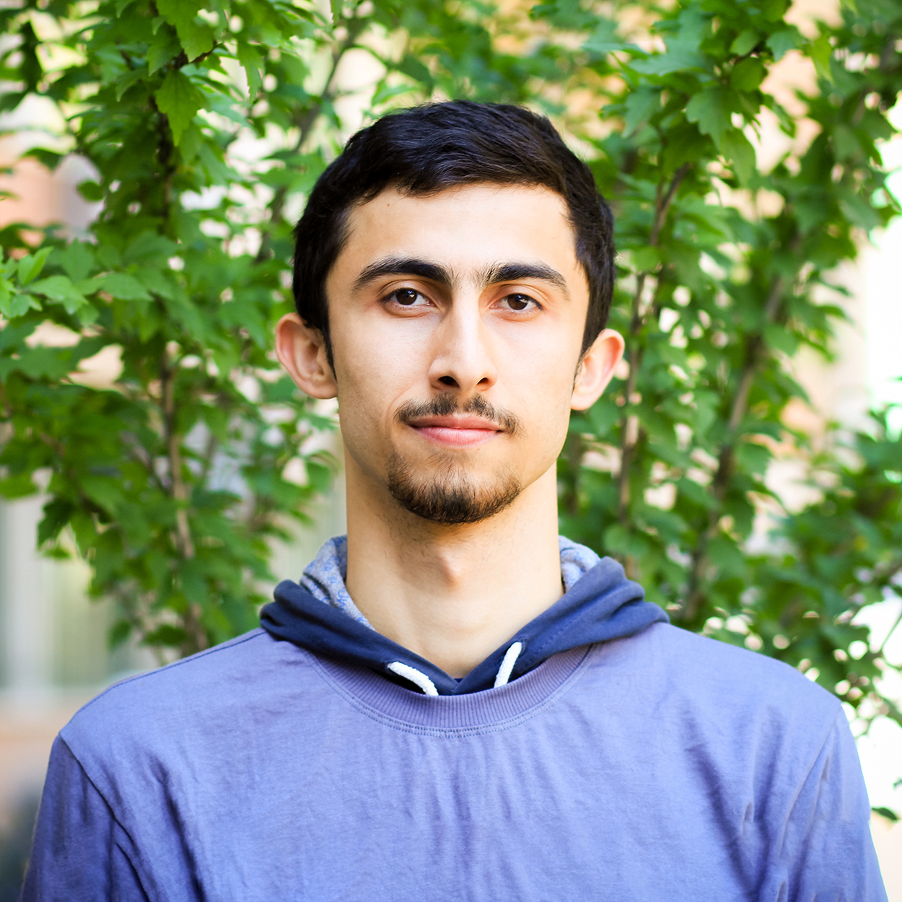
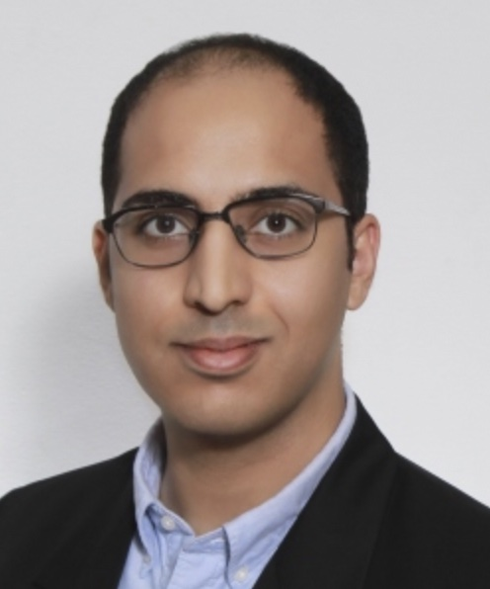
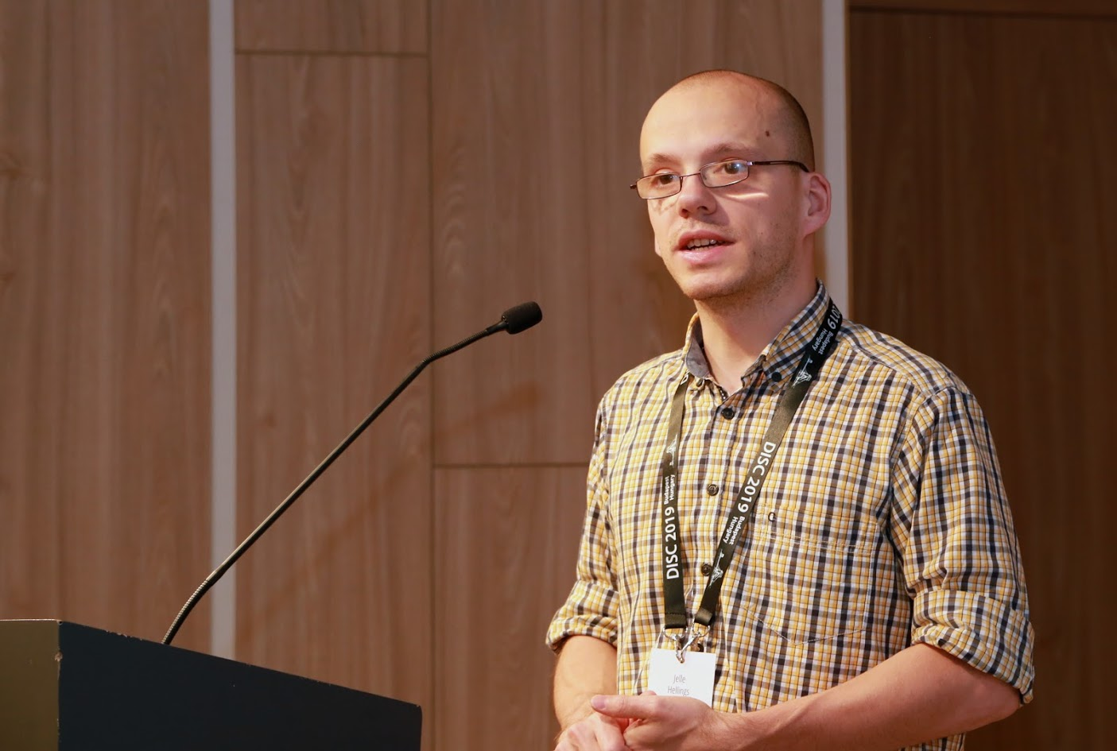
Awesome Collaborators
Sajjad Rahnama
Mohammad Sadoghi
Natacha Crooks
University of California, Berkeley
University of California, Davis
Faisal Nawab
University of California, Irvine
Jelle Hellings
McMaster University

Slide 3
Statutory Warning!
In this talk
We will not learn how to trade cryptocurrencies.
We will not mine Bitcoins.
I do not know NFTs!

Slide 4
One Line Problem Statement
Distributed systems managed by untrusted parties need fast and reliable protocols to manage their data.

Slide 5
Bank
Savings
Savings
Bob
Alice

Slide 6
Bank
Lost Job
Blocks her Savings
Misses Loan Payments
House Loan
Buys House
House
Bob
Alice

Slide 7
How could this happen?
Centralization
Monopoly
Lack of Control
No Voice

Slide 8
Solution???

Slide 9
Blockchain Technology
Decentralization
Democracy
Control of Data
Right to Vote

Slide 10
What is Blockchain?
New
Block
Previous
Hash
Genesis
Previous
Hash
Previous
Hash
Data
Data
Data
Client Transactions
Linked List of Blocks
Hash of Previous Block

Slide 11
Blockchain Network
Alice
Bob

Slide 12
Blockchain: Decentralization → Replicas
Alice
Bob

Slide 13
Blockchain: Democracy → Vote
Alice
Bob

Slide 14
Voting Rules → Consensus
Every replica should vote once!
Count each vote only once!
Winner → who gets majority of votes.
Ensure only one winner!

Slide 15
Everything is fine until there are Adversaries!
Alice
Bob

Slide 16
Solution → Byzantine-Fault Tolerant Consensus
Secure
Authenticated

Slide 17
Minimal Expectations!
Be Safe → All replicas should have same state.
X = 1
X = 1
X = 1

Slide 18
Minimal Expectations!
Stay Live → System should continue processing transactions from good clients.

Slide 19
First practical BFT implementation.
Practical Byzantine Fault Tolerance (PBFT)
Client
T
Primary
Replica 1
Replica 2
Byzantine
Client
Request
Pre-Prepare
O(n)
Prepare
O(n²)
Commit
O(n²)
Reply
Execute
Two Phases of O(n²)!!!
Consensus among n replicas & at most f byzantine → n >= 3f+1
n = 4 replicas and f <= 1

Slide 20
Several Exciting Solutions
Twin-path protocols →
Zyzzva [SOSP’07], SBFT [DSN’19]
Fast-path (no failures), and If failures → Slow-path like PBFT.
Severe throughput degradation during path switching.
Streamlined protocols →
HotStuff [PODC’19]
Linear consensus with no support for concurrent consensus invocations.

Slide 21
GeoBFT [VLDB’20]
RingBFT [EDBT’22]
Reliable Edge [arxiv’22]
RCC [ICDE’21]
FlexiTrust
[arxiv’22]
PoE [EDBT’21]
ResilientDB
[ICDCS’20]
PBFT

Slide 22
Speculative Execution
Proof-of-Execution (PoE)*
Three-phase Linear protocol
Out-of-Order Consensuses
No dependence on clients or trusted component.
*In proceedings of EDBT 2021.

Slide 23
Proof-of-Execution (PoE)
Client
T
Primary
Replica 1
Replica 2
Byzantine
Replica
Client
Request
Pre-Prepare
Prepare
Certify
Reply
Execute
n = 4 replicas and f <= 1

Slide 24
Magical Ingredient → Client Commit implies Finality
If client receives n-f responses → Transaction will persist in time.
Replicas may be required to rollback.

Slide 25
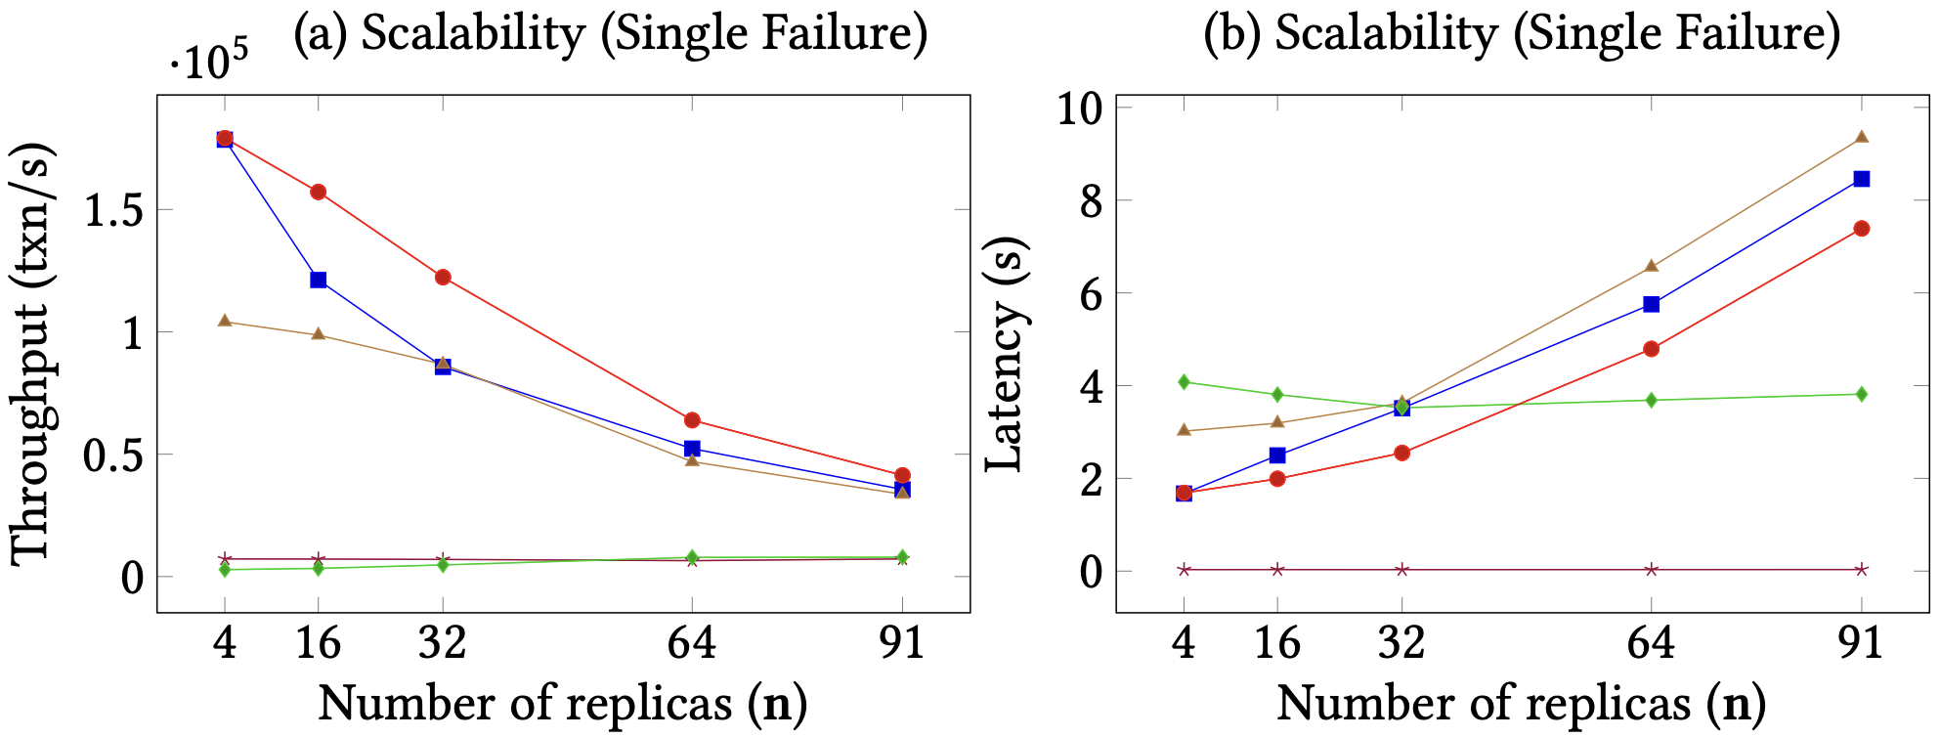
PoE Scalability

Slide 26
What if replicas are globally scattered?

Slide 27
Challenges For Geo-Scale Blockchains
High!
Low!
Blockchain expects decentralization → Replicas maybe geo-distributed

Slide 28
GeoBFT Protocol*
Local Replication
Inter-cluster Sharing
Ordering and Execution
Each cluster runs BFT to select, locally replicate, and certify a client request.
Primary at each cluster shares the certified client request with other clusters.
Order the certified requests, execute them, and inform local clients.
Topology-aware meta-protocol.
Parallel consensus at each cluster.
Low inter-cluster communication overheads.
*In proceedings of VLDB 2020.

Slide 29
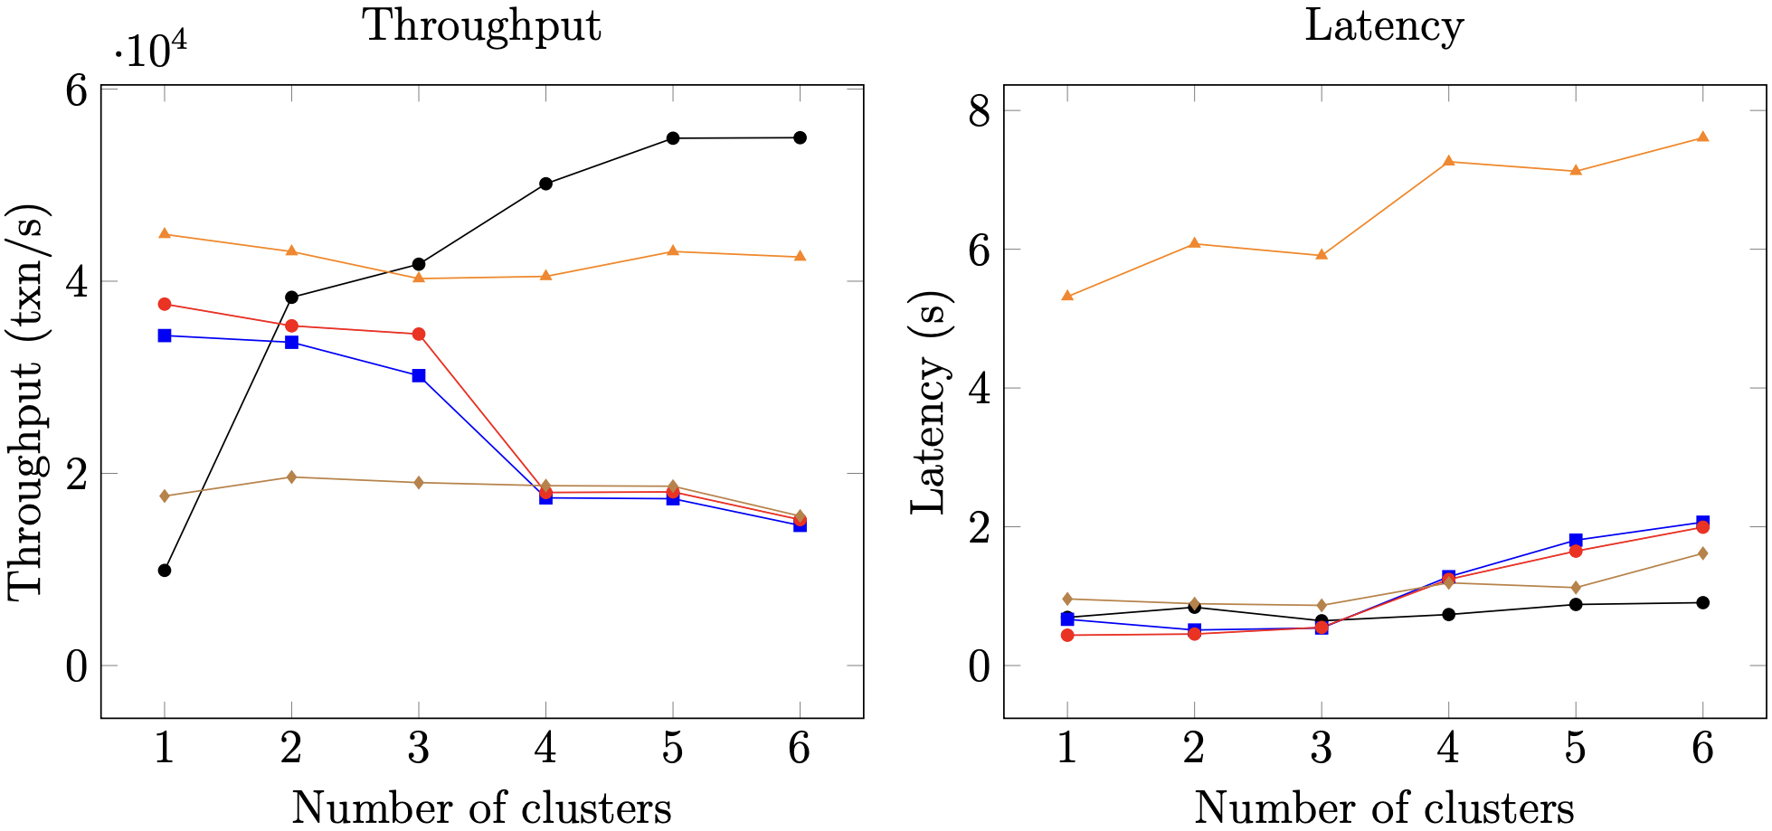
GeoBFT Scalability

Slide 30
What Limits Current Systems? Primary-Backup Paradigm
OK
OK
Replace Primary
System Halts
Order Txn
Primary
OK
Fall in throughput!
Primary

Slide 31
Our Proposal
Democracy → Give all the replicas the power to be the primary.
Parallelism → Run multiple parallel instances of a BFT protocol.
Decentralization → Always there will be a set of ordered client requests.
Resilient Concurrent Consensus

Slide 32
RCC Paradigm*
Parallelism
Ordering
Execution
BFT protocol
Run z parallel BFT
instances.
Create a global order
of all the requests.
Execute the requests
in a global order.
Number of
Instances (z)
*In proceedings of ICDE 2021 and DISC 2019.

Slide 33
Client
T
1
Primary
Replica
2
1
Replica
2
Client
T
Primary
Replica
1
2
Byzantine
Replica
1
2
Request
Pre-Prepare
Prepare
Commit
Reply
RCC using PBFT with 2 parallel instances.

Slide 34
Challenges?
How to securely order the requests?
Does failure of one instance causes other instances to stop?
Can there be continuous ordering of requests?
How to fend against coordinated attacks?

Slide 35
Ordering Attack
transfer(A,B,m) → if
bal(A) > m
then
bal(A) = bal(A) – m;
bal(B) = bal(B) + m;
Benefit to Bob!
T1: transfer(Alice, Bob, 2)
T2: transfer(Bob, Eve, 1)
Alice
Bob
Eve
3
1
5
0
5
2
0
3
0
2
0
1
Case 1: T1 then T2
Case 2: T2 then T1

Slide 36
Magical Ingredient → Secure Ordering
In round r, each replica does the following:
Collects requests from the z instances.
Hash each requests.
Creates a sequence S of these hashes.
Calls the function fS on S.

Slide 37
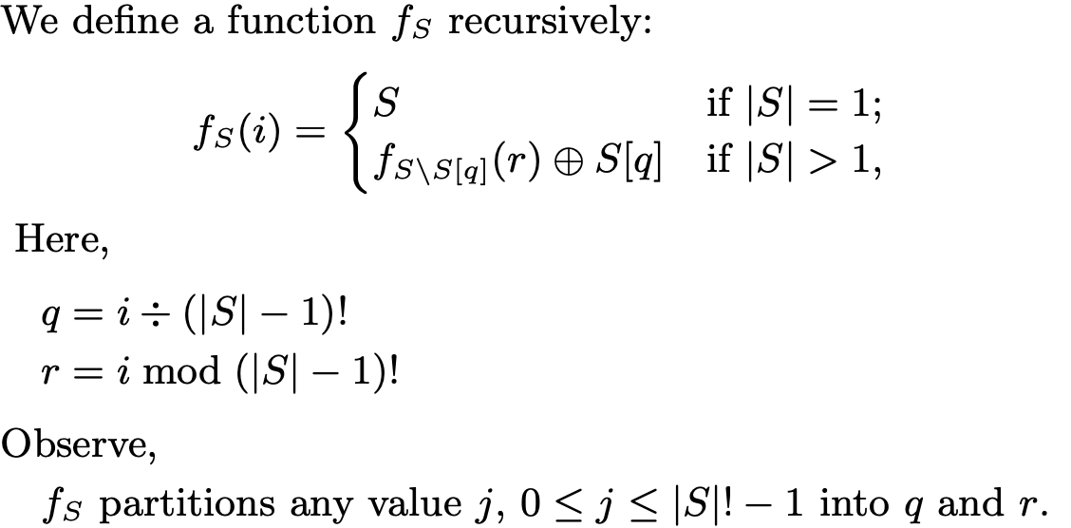
Magical Ingredient → Secure Ordering

Slide 38
Malicious Primaries Collusion
Good Replicas
|A| = f
Good Replica
|C| = 1
Good Replicas
|B| = f
T₁
T₁
T₂
T₂
T₁
T₂
P₁
|M| = f
Liveness in Danger!
P₂
Other f-2
Malicious Replicas

Slide 39
Magical Ingredient → Good Instances are always Live
Failed instances are stopped and not replaced through independent consensus.
Failed instances can be restarted in future.
Failed instances are stopped and not replaced through independent consensus.
Failed instances can be restarted in future.
Collusion attacks detected when f+1 blame multiple primaries.
Lightweight checkpoints ensure progress.

Slide 40
ResilientDB: High Throughput Yielding, Scalable Permissioned Blockchain Fabric*
Visit at: https://resilientdb.com/
*In proceedings of ICDCS 2020 and VLDB 2020.

Slide 41
Why Should You Chose ResilientDB?
Bitcoin and Ethereum offer low throughputs of 10 txns/s.
Existing Permissioned Blockchain Databases still have low throughputs (20K txns/s).
Prior works blame BFT consensus as expensive.
System Design is mostly overlooked.
ResilientDB adopts well-researched database and system practices.

Slide 42
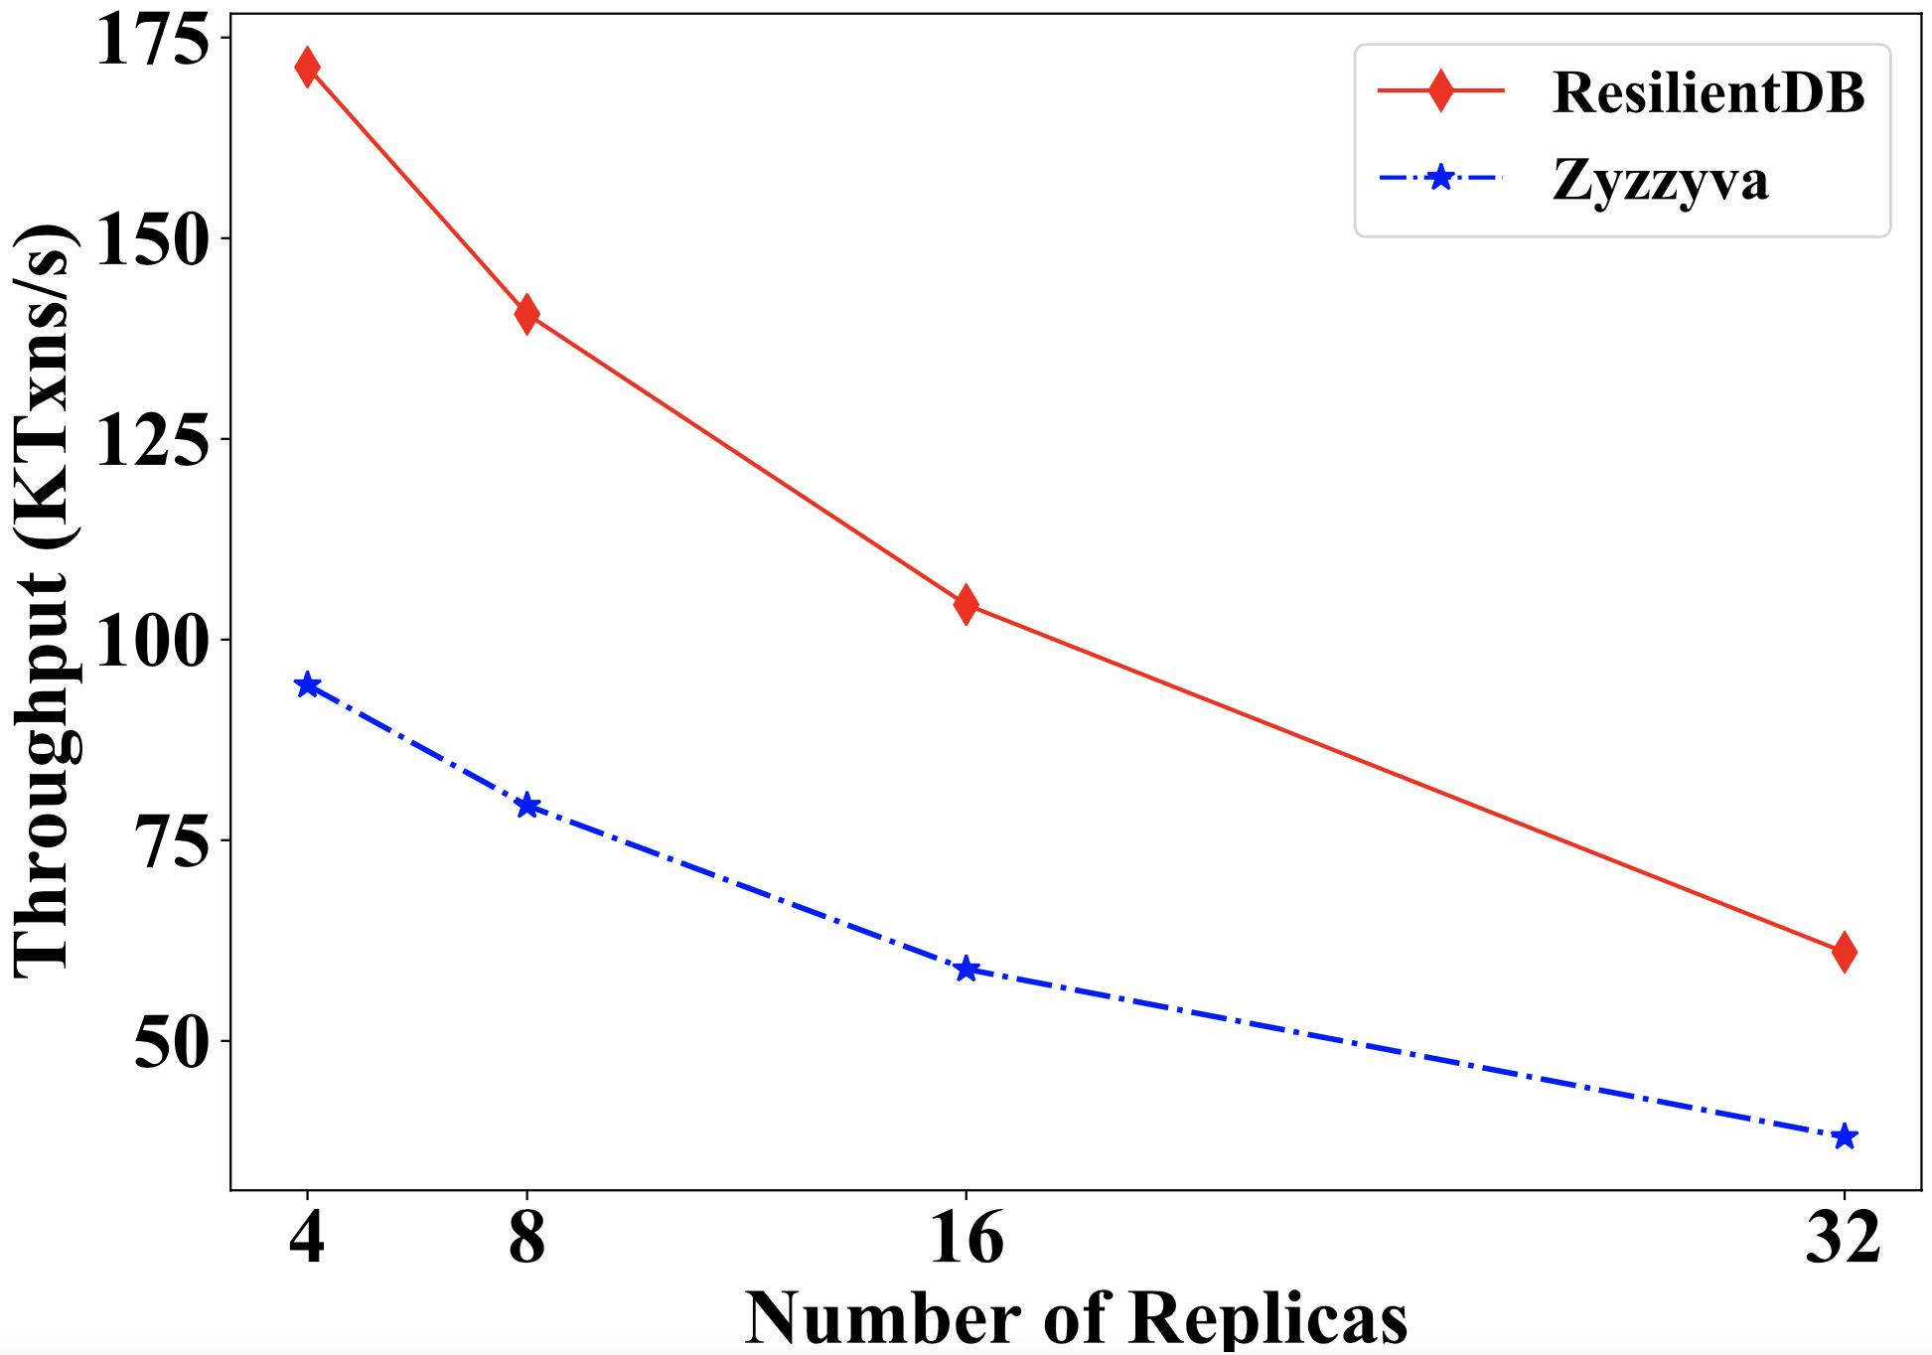
Can a well-crafted system based on a classical BFT protocol outperform a modern protocol?

Slide 43
ResilientDB Architecture
SECURE
LAYER
EXECUTION LAYER
THREADS
SIGNING
TOOLKIT
QUEUES
NET WORK
HASHING
TOOLKIT
BFT CONSENSUS
STORAGE LAYER
METADATA
BLOCKCHAIN

Slide 44
Implementation on ResilientDB
Network
Network
REPLICA
Client
Requests
Batching
Prepare & Commit
messages
Input
Output
Message from
Clients and Replicas
Message to
Replicas or Clients
Worker
Execute
Certificates
from other clusters
Certify
ResilientDB associates a multi-threaded deep-pipelined architecture with each replica.

Slide 45
Evaluating RCC on ResilientDB

Slide 46
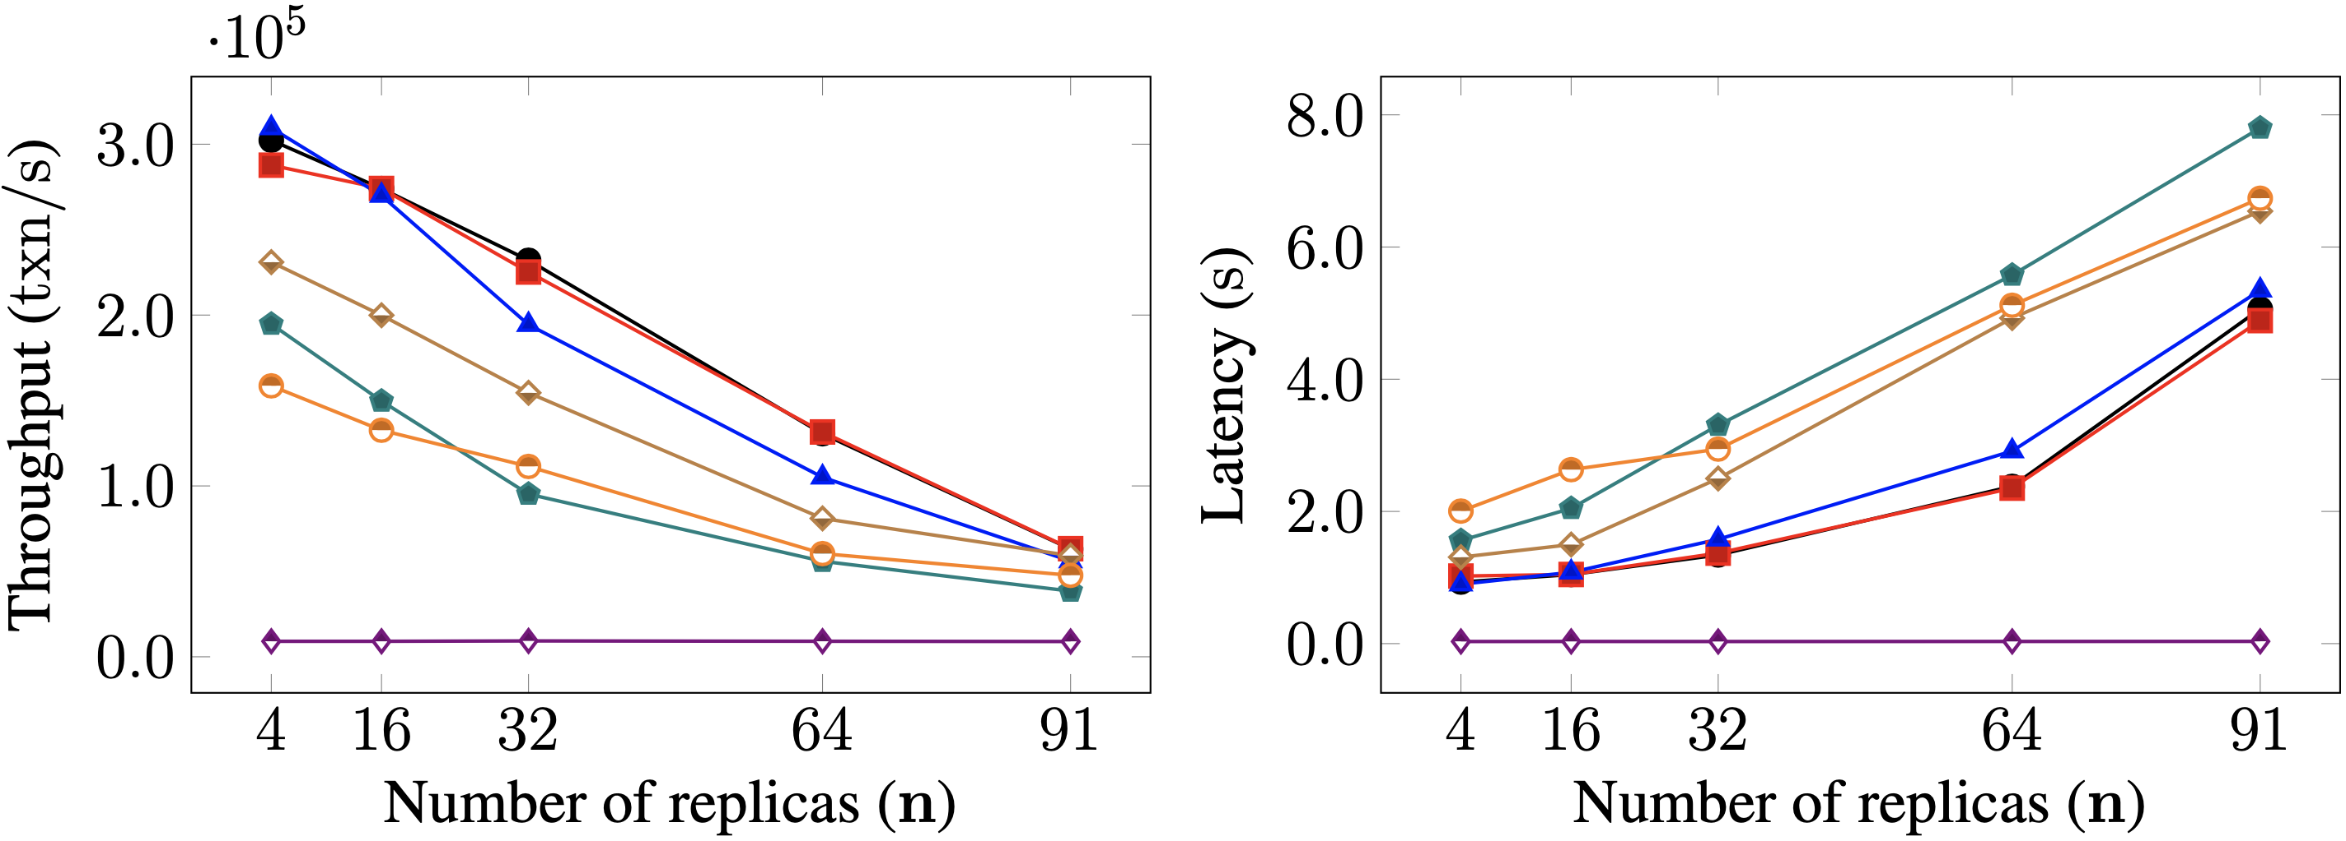
Scalability

Slide 47
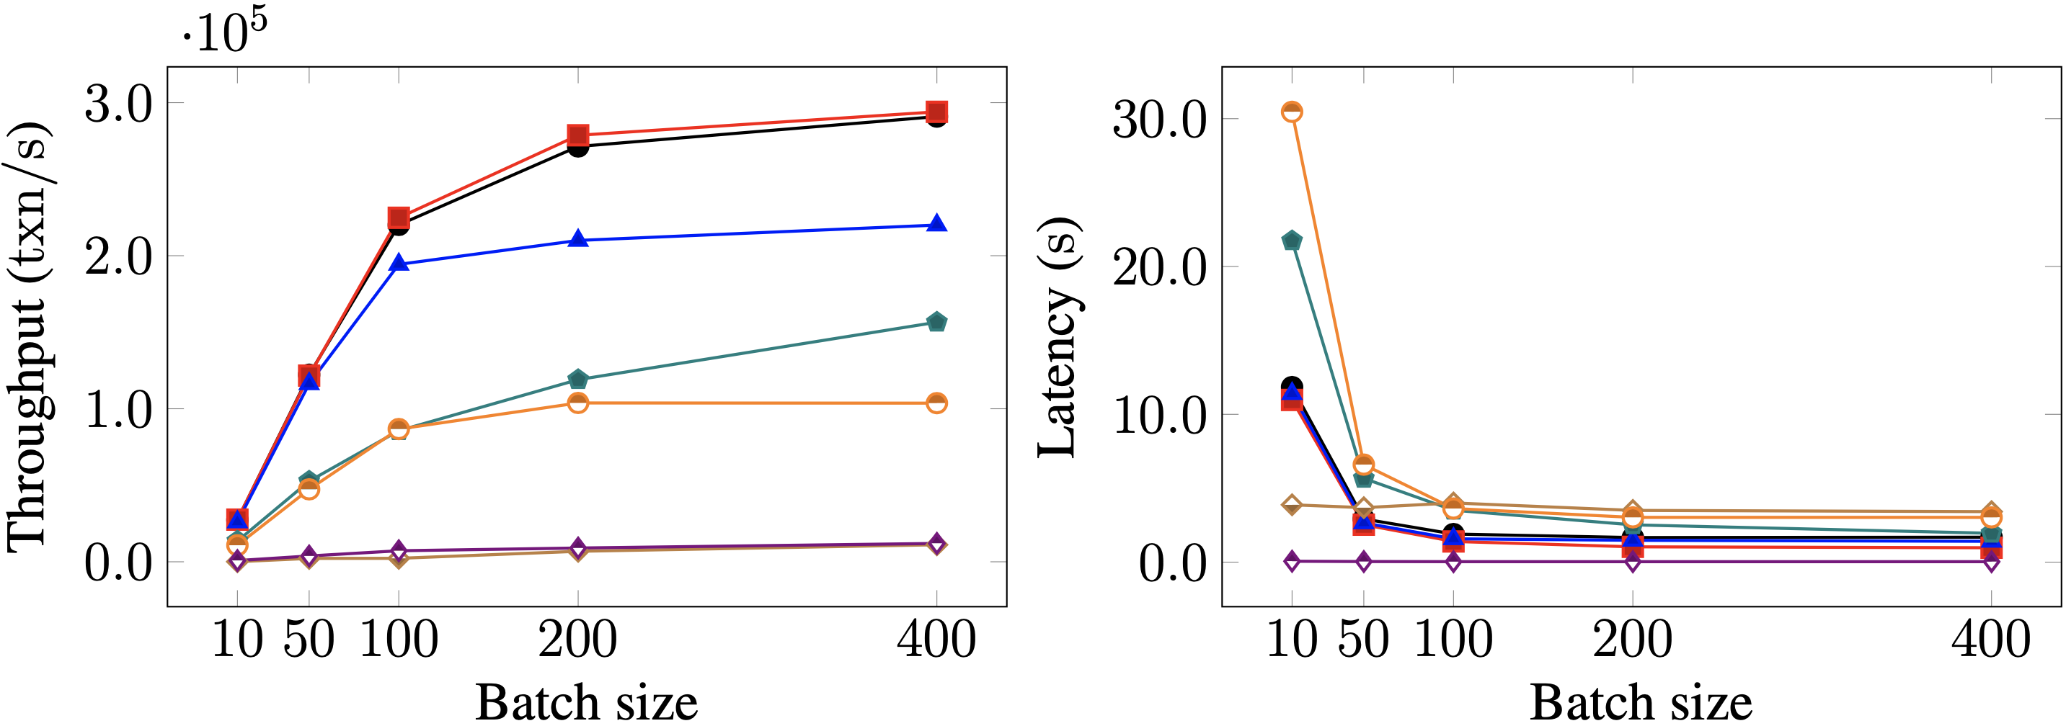
Batching

Slide 48
The Big Picture…
Blockchain as a Service

Slide 49
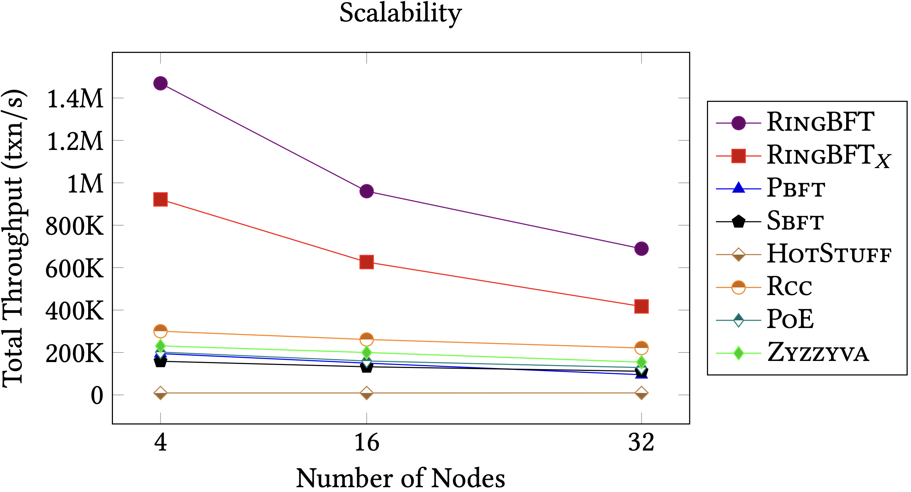
RingBFT: Resilient Consensus over Sharded Ring Topology*
Partitioning (sharding) data across shards helps to scale out.
Existing sharding protocols ignore complex cross-shard txns.
RingBFT scales up to 500 nodes across 15 regions in 5 continents.
RingBFT reaches throughput of 1 million txns/s.
*In proceedings of EDBT 2022.

Slide 50
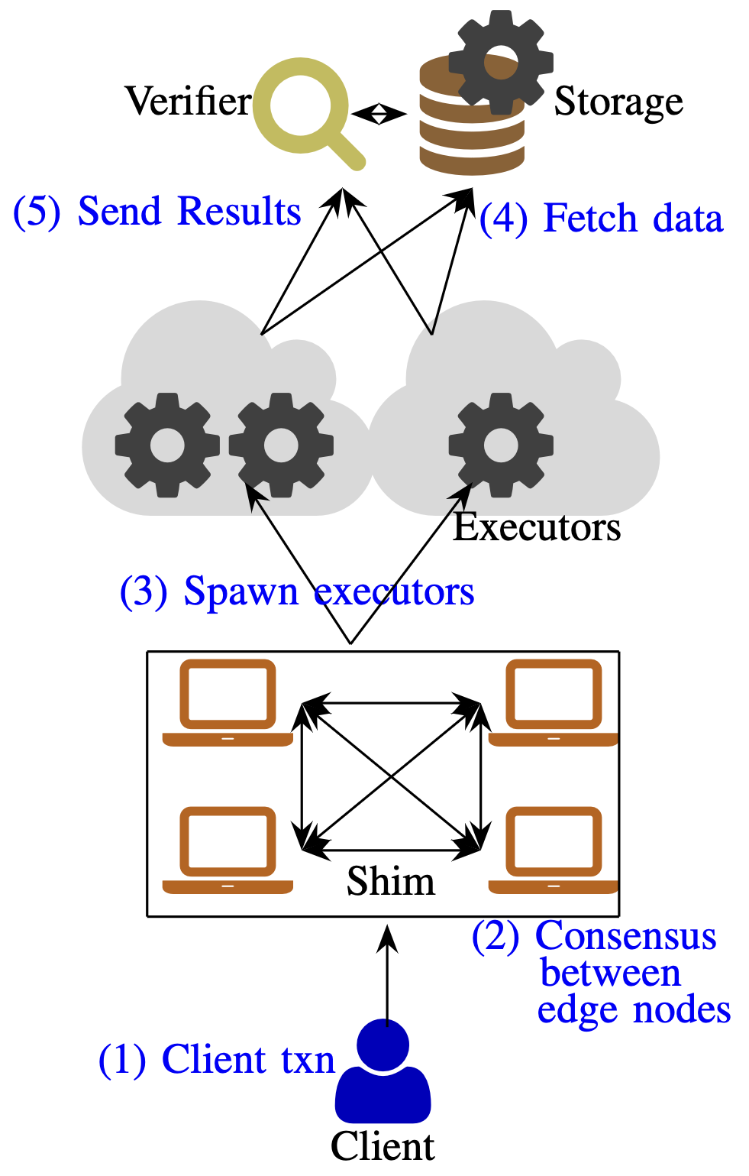
Reliable Transactions in Serverless-Edge Architecture
Edge systems such as IoT serve untrusting parties.
Edge devices require cloud support for computation.
Edge applications require ordering!
How to make this system malicious-resistant!

Slide 51
Dissecting BFT Consensus: In Trusted Components we Trust!
Existing BFT protocols using Trusted Components
Prevent Equivocation
Require 2f+1 replicas
Our Observations
Limited Liveness, Safety, and Lack Concurrency.
Our Proposals
New suite of protocols: FlexiTrust → Safe, Live and Concurrent Protocols.

Slide 52
Thank You

