Slide 1
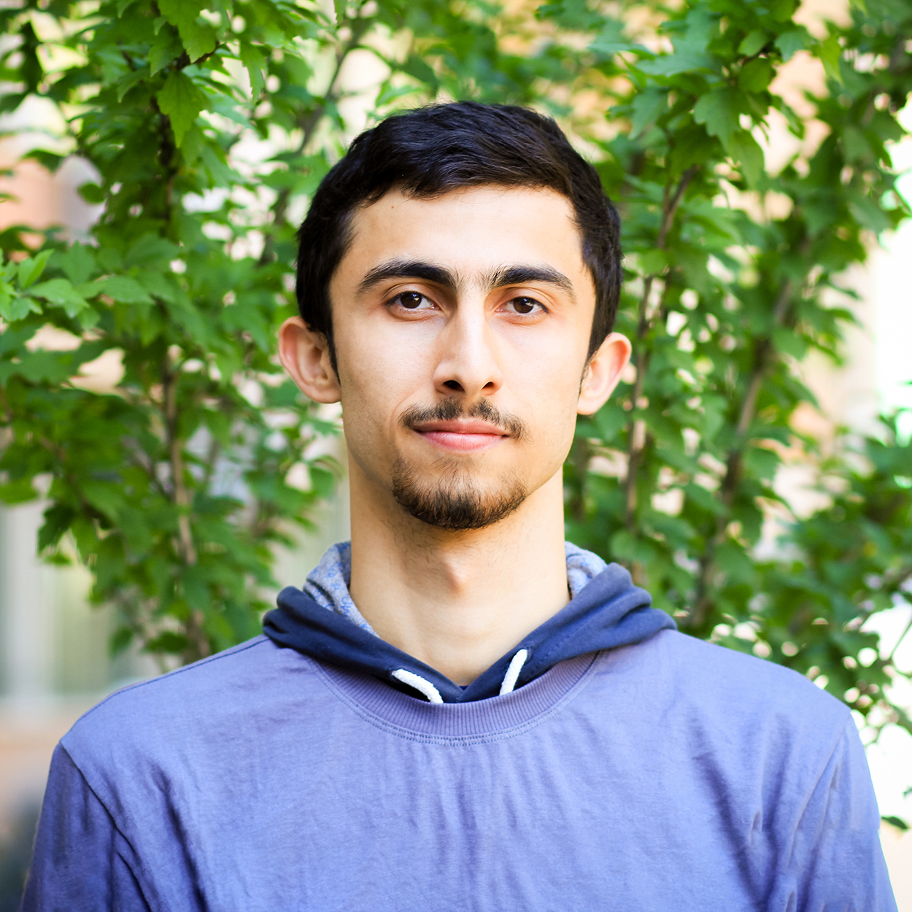
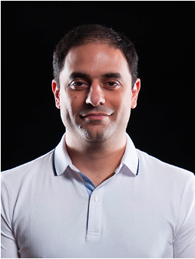
Dissecting BFT Consensus:
In Trusted Components we Trust!
Suyash Gupta
UC Berkeley
Sajjad Rahnama
ExpoLab
UC Davis
Shubham Pandey
ExpoLab
UC Davis
Natacha Crooks
UC Berkeley
Mohammad Sadoghi
Expolab
UC Davis

Slide 2
Why Should this Talk Interest you?
Bad News
Good News
Trusted Hardware
cannot be used
to efficiently reduce replication factor of BFT protocols to 2f+1.
Trusted Hardware
can be used
to design more efficient and scalable 3f+1 BFT protocols.

Slide 3
Replicated State Machine

Slide 4
Replicated State Machine
Safety → Consistent log of operations.
Liveness → Replicas should make progress.
Responsiveness → Client should receive response.

Slide 5
Byzantine Fault Tolerant RSM
n replicas & at most f byzantine → n >= 3f+1
Run Byzantine Fault Tolerant (BFT) Consensus

Slide 6
Byzantine Fault Tolerance Consensus
Transaction
n = 3f+1 replicas
Alice
Result
Non-Equivocation Phase
Request is prepared
Persistence Phase
Request is committed
Execution Phase

Slide 7
Non-Equivocation
Create a Prepare Quorum:
No two prepare quorums can exist for
different transactions at the same sequence number.
Every quorum needs to intersect in at least one honest replica.
2f+1
2f+1
f+1

Slide 8
Persistence
If a new leader is elected,
RSM should ensure that
previously committed requests persist.

Slide 9
Execution
Client needs f+1 matching responses.
Ensures execution by one honest replica.
Proof of request commitment not sufficient.

Slide 10
The Ugly Side of BFT
Crash Fault Tolerant Systems
2f+1 replicas
Byzantine Fault Tolerant Systems
3f+1 replicas
Equivocation is root cause of higher replication factor

Slide 11
Maybe Trusted Hardware Can help?

Slide 12
Trusted Byzantine Fault-Tolerance Consensus
Trusted component attest order of each transaction.
Replicas cannot equivocate.
A2M, TrInc, MinBFT, MinZZ, CheapBFT, Hotstuff-M, Damysus
Trust-BFT protocols → 2f+1 enough for safety

Slide 13
Trust-Byzantine Fault Tolerance Consensus
Transaction
n = 2f+1 replicas
Alice
Result
Non-Equivocation Phase
Request is prepared
Persistence Phase
Request is committed
Execution Phase

Slide 14
Trust-Byzantine Fault Tolerance Consensus
Transaction
Alice
Result
f+1 replicas vote prepare.
Request is prepared
f+1 replicas vote commit
Request is committed
Any replica that commits, executes.

Slide 15
So Are We Done?
Unfortunately No!

Slide 16
Hidden Pitfalls with Trust-BFT Protocols
Algorithmic Pitfall
Limited Responsiveness
Loss of Safety under Rollbacks
Lack of Parallelism
Measurement Pitfall
Instead of focusing on reducing replication → Focus on increasing Throughput per Machine.

Slide 17
Limited Responsiveness
Transaction
Quorum Size = f+1 = 2
Alice
Request is prepared
Honest replica sends Result
Request is committed
Honest replica that commits, executes.

Slide 18
Alice Stuck!
Alice needs f+1 = 2 matching responses.
Alice receives only 1 response.

Slide 19
No progress for Alice
View Change
Alice
Resend
Need at least f+1
??

Slide 20
Lack of Parallelism
Every message sent requires an attestation bound to specific sequence number.
Replicas cannot run consensus on two transactions in parallel!
We show that despite 2f+1 replicas, Trusted-BFT protocols are slower than BFT.

Slide 21
Loss of Safety under Rollbacks
Trusted Enclaves can be rollbacked!
On enclave rollback, safety cannot be guaranteed.
Possible Solution? Make use of TPMs or persistent counters!
Too slow → 180ms per access.
Very few writes → TPMs allow at most 1 million writes.
Trust-BFT protocols require O(n) accesses per consensus phase.

Slide 22
Solution → FlexiTrust Protocols
A novel suite of protocols.
Guarantee both liveness and responsiveness.
Require access to trusted component only once per consensus.
Employing TPMs to avoid enclave rollbacks is now much less expensive!

Slide 23
Magical Ingredients behind FlexiTrust Protocols
Switch back to replication factor 3f+1.
Larger Quorums guarantee responsiveness.
Trusted hardware accessed only by the primary before sending proposal.
Guarantees non-equivocation.
Permits replicas to participate in multiple consensus invocations in parallel.
Helps to reduce phases and communication.

Slide 24
Single phase, Linear, Handles f failures, Only needs Trusted counters.
Flexi-ZZ Protocol!
Alice
T
Primary (P)
T_{P}
Replica (R1)
Replica (R2)
Replica (R3)
Client
Request
Pre-Prepare
Reply

Slide 25
Evaluation on ResilientDB*
*https://resilientdb.com/

Slide 26
Throughput per Machine
MinZZ → Single phase like FlexiZZ but n >= 2f+1.
For these experiments, we deployed up to 80k clients.

Slide 27
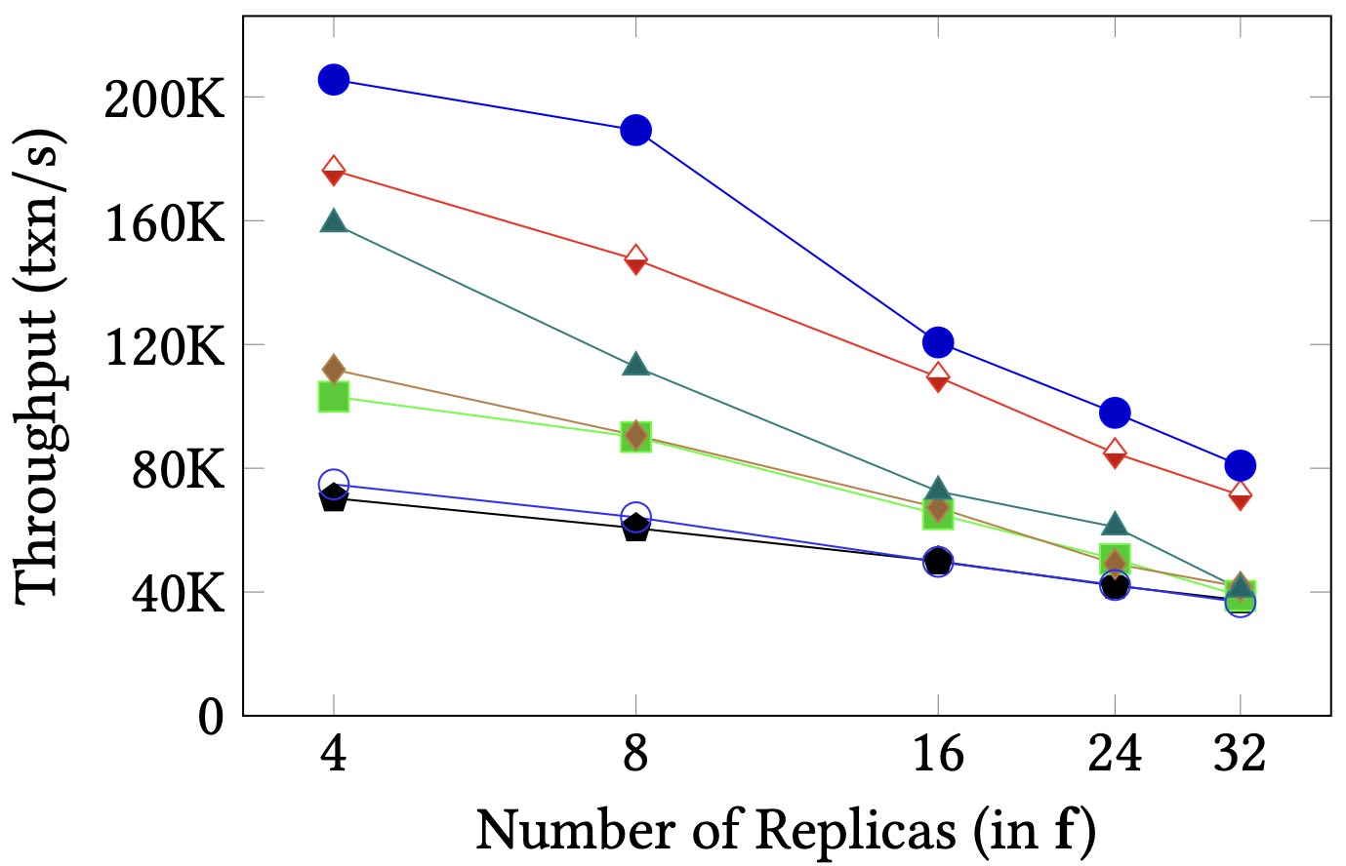
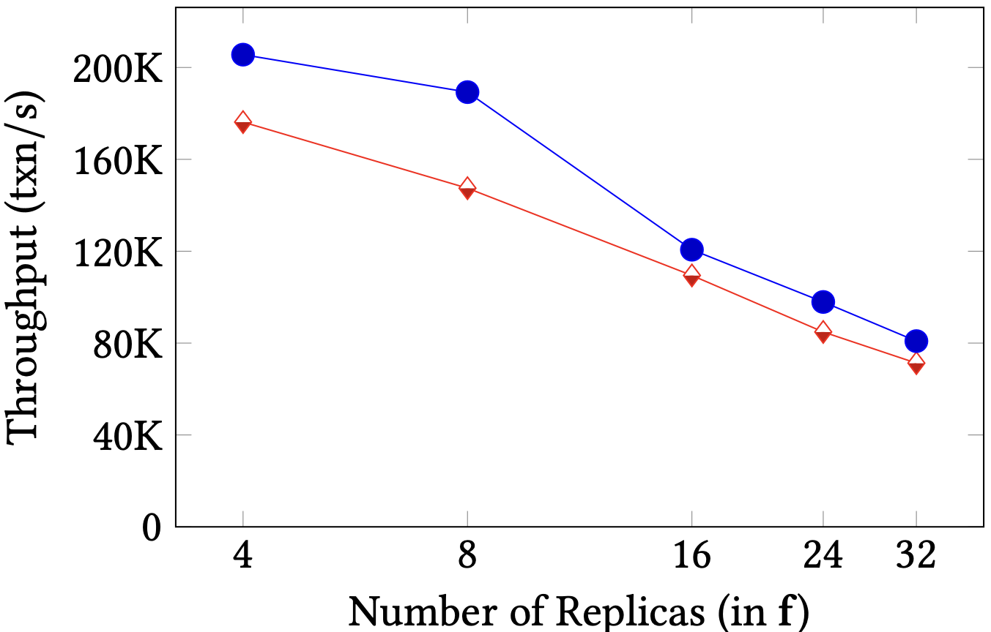
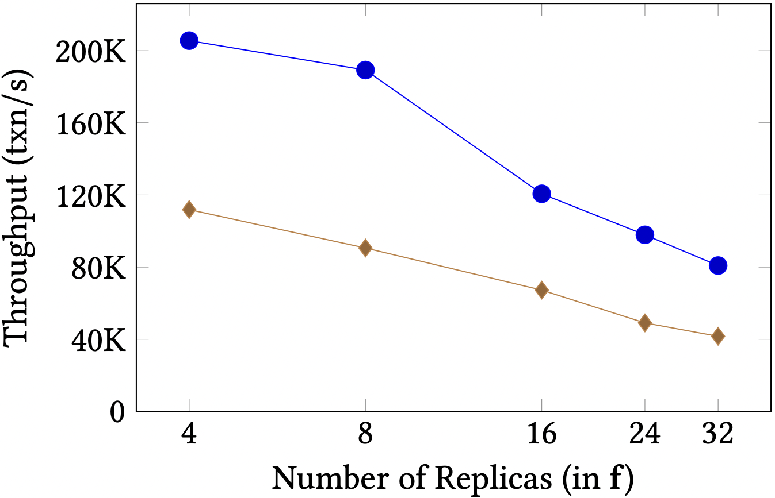
Scalability
95.5%
Number of replicas (f=8)
N = 17 → PBFT-EA, MinBFT, MinZZ, OPBFT-EA
N = 25 → PBFT, FlexiBFT, FlexiZZ

Slide 28
Conclusions:
Simply reducing replication will not yield higher throughput.
Existing Trust-BFT protocols limit responsiveness and scalability.
FlexiTrust protocols advocate meaningful application of BFT consensus.
Reach me:
Twitter: suyash_sg
Email: suyash.gupta@berkeley.edu
Web: https://gupta-suyash.github.io/

