Slide 1
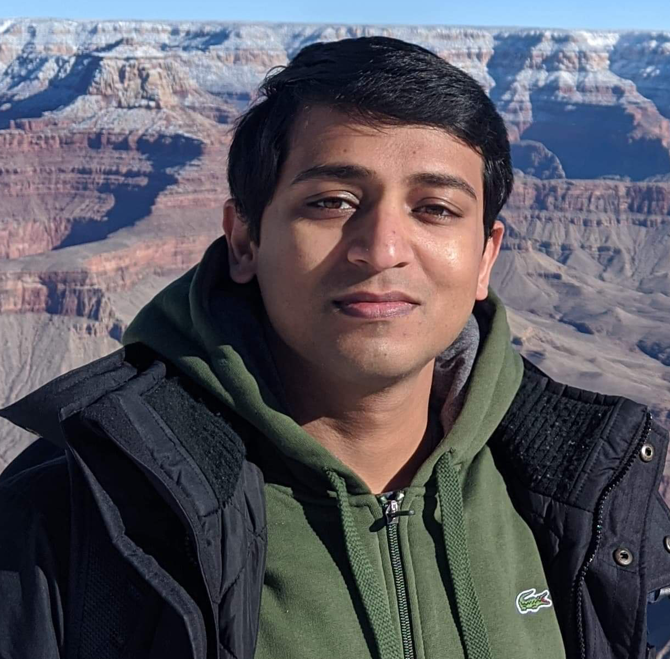

Large Scale Systems CS 410 / 510
Suyash Gupta
Assistant Professor
Distopia Labs and ORNG
Dept. of Computer Science
(E) suyash@uoregon.edu
(W) gupta-suyash.github.io

Slide 2
Welcome!

Slide 3
Course Webpage: https://gupta-suyash.github.io/cs410-fall24.html Course Canvas: https://canvas.uoregon.edu/courses/265485

Slide 4
Instructors
Suyash Gupta
Office Hours: Wednesday, 10-11am, Deschutes 334

Slide 5
TextBooks
Main Course Book:
Principles of Distributed Database Systems (4/e by Tamer Ozsu).
Fault-Tolerant Distributed Transactions on Blockchains (1/e by Gupta).

Slide 6
Grading Scheme
 | Percentage
Project | 60%
Presentations | 20%
Class Participation | 20%
No Exams!!!
Rubric
95% - A+
90% - A
85% - A-
80% - B+
75% - B
70% - B-
65% - C+

Slide 7
Project
Projects should be completed in groups of 3.
Every student in the group needs to state their contribution.

Slide 8
Project
The goal of the project is to build a MiniSpanner, like Google’s Spanner.
Thus, the project is divided into 4 incremental Assignments.
Each assignment carries 15% of the credit.
Each assignment submission is a Latex report (no code)!
Assignments for CS 410 and CS 510 students will differ a little.

Slide 9
Project Assignment Schedule
 | Date Release | Date Due
Assignment 1 | 04/02/2025 | 04/16/2025
Assignment 2 | 04/16/2025 | 04/30/2025
Assignment 3 | 04/30/2025 | 05/18/2025
Assignment 4 | 05/18/2025 | 06/02/2025
All assignments are due at 11:59pm. Post that it will be considered as late.

Slide 10
Late Days
Each group has 2 Late Days.
You can use these late days in any assignment.
Late Days allow you to miss the deadline.

Slide 11
Plagiarism
Please don’t plagiarize.
Just don’t!
We will apply the harshest UO policy available to us to deal with plagiarism!
More details on the webpage.

Slide 12
Presentations
In the week of 6/2 – 6/6, we will have presentations.
Each group will get 30 minutes to present the design of their MiniSpanner.
15 min presentation through slides (5 min per student)
5 min for live demo.
10 min Q/A.

Slide 13
Large Scale Systems CS 410 / 510
Lecture 1:
Overview: Why Large Scale Systems
Suyash Gupta
Assistant Professor
Distopia Labs and ORNG
Dept. of Computer Science
(E) suyash@uoregon.edu
(W) gupta-suyash.github.io

Slide 14
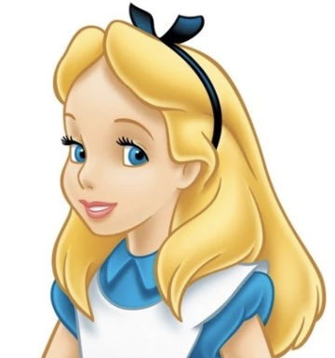
Meet Alice
This is Alice.

Slide 15
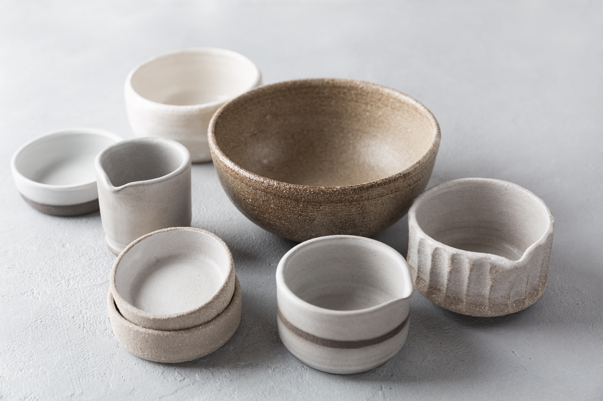
Meet Alice
This is Alice.
She makes designer pots and wants to sell them online.

Slide 16
What Should Alice Do?
This is Alice.
She makes designer pots and wants to sell them online.

Slide 17

Step 1: Creates an HTML Page
Alice creates an HTML/CSS page that lists all the pots and their price.

Slide 18
What Next? Is Alice done?
Alice creates an HTML/CSS page that lists all the pots and their price.

Slide 19
Step 2: Upload the Page on the Web
How to upload a page on the web?

Slide 20

Step 3: Buy a Domain and Set up a Server
Alice buys a domain: PotsForAll.com
Alice buys a computer and sets it up as a server for this website.

Slide 21
Why the term Server?

Slide 22
Why the term Server?
It serves all client requests.

Slide 23
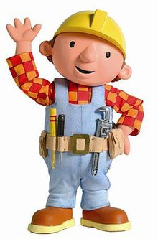
Why the term Server?
This is Bob.
He likes the pots that Alice makes and wants to purchase one online.

Slide 24
Why the term Server?
Bob sends server a request to buy a brown pot.

Slide 25
Why the term Server?
Bob sends server a request to buy a brown pot.
Once Bob’s payment succeeds, the server sends Bob an order confirmation receipt.

Slide 26

Challenge 1: Failures
What if Alice’s computer gets infected with a virus?
Or what if Alice’s computer crashes?
How will she fulfill client requests?

Slide 27
Need for Replication
Initial Server
Replicas
Alice should replicate her webpage on multiple computers.
Have multiple computers store a copy of her webpage.

Slide 28
How does Replication help?
Initial Server
Replicas
Alice now has replicas of her webpage.

Slide 29
How does Replication help?
Initial Server
Alice now has replicas of her webpage.
If one computer has a virus, she can quickly make another computer as server.

Slide 30
How does Replication help?
New Server
All future client requests will be re-directed to new server.

Slide 31
What Next? Is Alice done?
Initial Server
New Server
Any other challenges?

Slide 32
Challenge 2: State Update
Initial Server
New Server
What state does the new server starts from?
Loss of client data?

Slide 33
Need for Consistency
Initial Server
New Server
New Server should include all the state and account updates of the old server.
Need a protocol to continuously updates all replicas → keep replicas consistent.

Slide 34
What Next? Is Alice done?
Initial Server
New Server
Any other challenges?

Slide 35
Challenge 4: Throughput
Bob wants to buy a cup.

Slide 36

Challenge 4: Throughput
Bob wants to buy a cup. Harry wants to buy a cup.

Slide 37
Need for High Throughput
The system should be able to process multiple client requests.
Should complete a large number of client requests per unit of time.

Slide 38
Challenge 5: Ordering
Say there is only one golden cup and both Bob and Harry send a request to buy the cup.
Who gets the cup?

Slide 39
Need for Transaction Ordering
The system should fairly order client requests/transactions.
Need to decide who gets the golden cup based on various factors, such as time of arrival of client transactions.

Slide 40
Challenge 6: Client View
Initial Server
New Server
How does client know which server to connect to?
How does client know that the old server failed and it needs to connect with the new server?

Slide 41

Need for a Proxy
Client
Proxy/ Frontend
Replicated Server/ Backend
Client only talks with the proxy.
Proxy knows the current server and delivers all client requests to server.

Slide 42
What Next? Is Alice done?
Client
Proxy/ Frontend
Replicated Server/ Backend
Any other challenges?

Slide 43
Challenge 7: Client Requirements
Client
Proxy/ Frontend
Replicated Server/ Backend
What other requirements/ expectations can clients have from the system?

Slide 44
Need for Responsiveness
Client
Proxy/ Frontend
Replicated Server/ Backend
Bob needs a response back from the system to know that his request was processed.
Bob somehow needs to verify that he received a correct response!

Slide 45
Need for Low Latency
Client
Proxy/ Frontend
Replicated Server/ Backend
Bob needs a response back from the system as fast as possible.
A system should thrive to reduce the time a client sends a request to time when the client receives a response for its request.

Slide 46
System Modeling
When designing a system, a developer needs to lay down the system model, which requires stating various properties.
System Properties
Safety – A system is safe if it guarantees consistency.
Liveness – A system is live if it is available despite failures.
Responsiveness – A system is responsive if it sends a response back to the client.
Note: Each modern system guarantees these properties under some network model.

Slide 47
System Modeling
System Metrics
Throughput – Number of transactions processed per second.
Latency – Time difference between a client sends a request to the time client receives a response back from the server.

Slide 48
Need for Scalability
What if Alice’s website becomes famous and has to handle billions of client requests daily, like Amazon!
Is continuously replicating billions of requests feasible? What can Alice do?

Slide 49
Replication vs. Sharding
We saw earlier that replication is necessary.
But, can we also partition data.
Sharding allows dividing data into distinct groups.

Slide 50
Need for Scalability
A
B
C
A
B
C
Fully Sharded System
A
B
C
A
B
Fully Replicated System
C

Slide 51
Sharded Replicated System
As sharding only supports data partitioning.
We still need availability.
So, internally each shard can be replicated.
Google’s Spanner is an example of sharded replicated system.

Slide 52
Case Study: How did Google perform massive compute?

Slide 53
Case Study: How did Google perform massive compute?
Even in early 2000’s, Internet was large.
Google wanted to process a large amount of data.
Often their developers wanted to apply same operations to the data.
They wanted to use the 1000s of computers they had to quickly perform operations.
So, what do you think they did?

Slide 54
Case Study: How did Google perform massive compute?
Example Operations: Sorting data, counting words, etc.
Solution: Map Reduce Framework!
Google published the seminal paper on Map Reduce.

Slide 55
Case Study: Map Reduce
Map Reduce architecture is a pipelined architecture.

Slide 56
Case Study: Map Reduce
Map Reduce architecture is a pipelined architecture.
Input
Map Tasks

Slide 57
Case Study: Map Reduce
Map Reduce architecture is a pipelined architecture.
Intermediate
Output
Input
Map Tasks

Slide 58
Case Study: Map Reduce
Map Reduce architecture is a pipelined architecture.
Intermediate
Output
Input
Map Tasks
Reduce
Tasks

Slide 59
Case Study: Map Reduce
Key Requirement: The tasks should be independent to allow split to happen.
Lets take an example: Count the total words in a file.
The map function takes a set of files as inputs and returns key, value pairs that identify each word.
The reduce function will try to aggregate them.

Slide 60
Case Study: Map Reduce
A, B
B, C
A, D
Input Files
Mappers

Slide 61
Case Study: Map Reduce
(A,1)
(B,1)
A, B
B, C
(B,1)
(C,1)
(A,1)
(D,1)
A, D
Output of Mappers
Input Files
Mappers

Slide 62
Case Study: Map Reduce
(A,1)
(B,1)
A, B
B, C
(B,1)
(C,1)
(A,1)
(D,1)
A, D
Output of Mappers
Input Files
Mappers
Reducers

Slide 63
Case Study: Map Reduce
(A,1)
(B,1)
A, B
B, C
(B,1)
(C,1)
(A,1)
(D,1)
A, D
Output of Mappers
Input Files
Mappers
Reducers

Slide 64
Case Study: Map Reduce
A,2
(A,1)
(B,1)
A, B
B,2
B, C
(B,1)
(C,1)
C,1
(A,1)
(D,1)
A, D
D,1
Output of Mappers
Output of Reducers
Input Files
Mappers
Reducers

