Slide 1
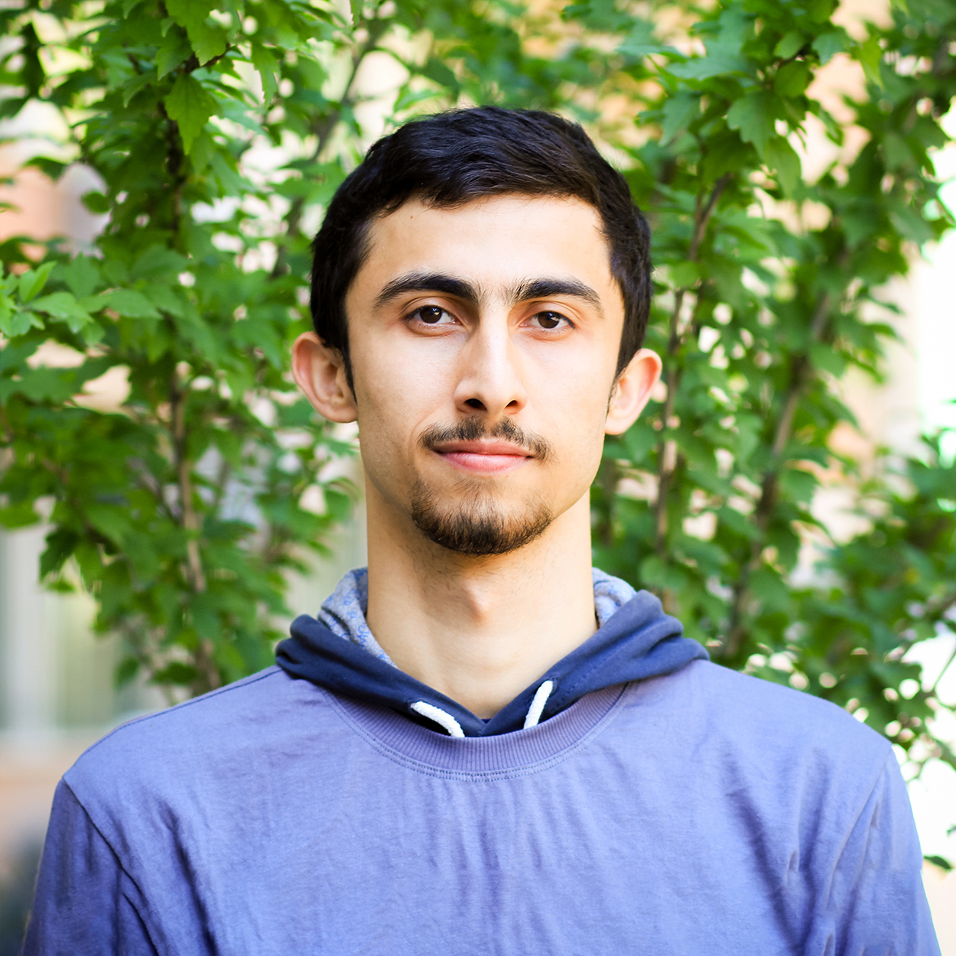
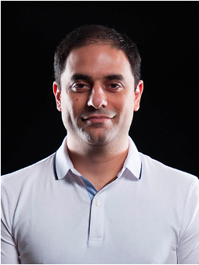
Reliable Transactions in Serverless Edge Architecture
Suyash Gupta
SkyLab
UC Berkeley
Sajjad Rahnama
Expolab
UC Davis
Faisal Nawab
EdgeLab
UC Irvine
Mohammad Sadoghi
ExpoLab
UC Davis

Slide 2
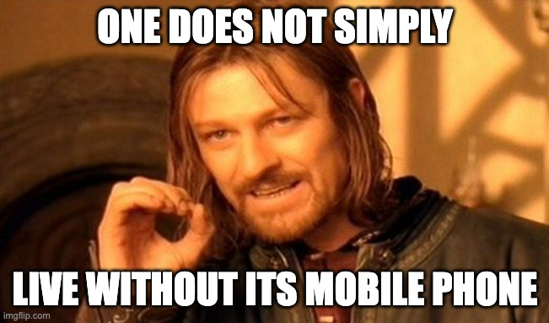
Omnipresent Edge Devices

Slide 3
Advent of Edge Computing
Train Machine Learning Models
Video Streaming
Online Gaming
Navigation

Slide 4
Requirements of Edge Computing
Computational Power
Memory

Slide 5
General Architecture
2) Local processing
3) Intensive processing
4) Result
1) Runs application

Slide 6
Characteristics of General Architecture
Advantages
Disadvantages
Easy Data Management
Unlimited Compute Power
Unlimited Memory
Communication round-trip
Dedicated Cloud Provider
If Edge servers → Scalability?

Slide 7
Proposed Architecture?
2) Local processing
3) Intensive processing
4) Result
1) Runs application

Slide 8
Characteristics of Proposed Architecture
Advantages
Disadvantages
Cheap round-trip
No dedicated cloud
Scalable
How to manage data?
What if a provider is faulty?

Slide 9
Serverless-Edge Co-design
2) Decision Making
3) Data processing
Serverless Clouds
1) Runs application
Shim
4) Results
Verifier

Slide 10
Characteristics of Serverless-Edge Co-design
Good News
Bad News
Data management decisions taken at shim and no trust on clouds and edge devices.
Consensus protocols that can handle attacks are needed!

Slide 11
Our Contribution: ServerlessBFT
Enables fault-tolerant transactional flow among
edge devices and serverless clouds.

Slide 12
Shim Characteristics
Edge devices in vicinity.
Run any consensus protocol.
To handle attacks: n >= 3f+1.
No excess compute or storage.

Slide 13
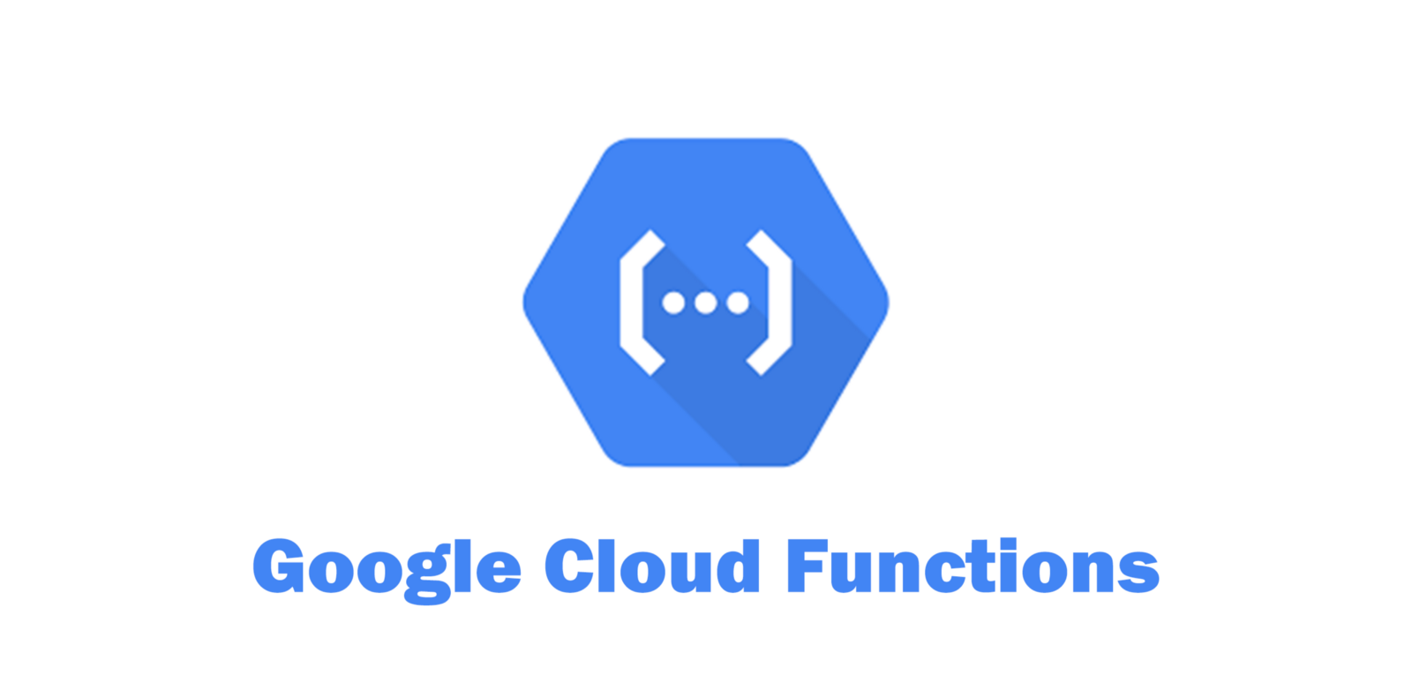
Serverless Characteristics
One or more serverless cloud providers.
Pay-per-use model.
Spawner billed by cloud provider.
To handle attacks: n >= 2f+1.

Slide 14
ServerlessBFT: Transactional Flow
Alice
Device
Device
Device
Device
Executor
Three phases of PBFT
Executor
Executor
Verifier

Slide 15
So Are we done?
Unfortunately No!

Slide 16
Key Challenges
How to handle serverless failures?
How to handle edge failures?
How to manage transactional conflicts?

Slide 17
Design and Implementation
Open sourced at https://resilientdb.com/

Slide 18
Evaluation: Effect of Cores

Slide 19
Evaluation: Effect of Executors

Slide 20
Evaluation: Effect of Shim Consensus

Slide 21
Conclusions
Serverless-edge co-design opens a new avenue of using edge and serverless architectures without any trust.
ServerlessBFT guarantees transactional flow protocol despite attacks.
Aims to guarantee consistency and progress.
Reach me
Twitter: suyash_sg
Email: suyash.gupta@berkeley.edu

